Slide 1
ACO EasyStop ND 40 or ND 50
stops
dry out of seal water in FAT
get through of smoke
get through of smell
Two diameter: ND 40 and ND 50
Retro fitable
From 1st October on stock
Part no. | Description | New IC Price
9010.79.23 | ACO EasyStop, ND 40 fits ACO ShowerDrain E, horizontal, ND 40
9010.79.24 | ACO EasyStop, ND 50 fits ACO ShowerDrain E, horizontal, ND 50 ACO ShowerDrain C, horizontal, ND 50 ACO ShowerDrain C, vertical, ND 50

Slide 2
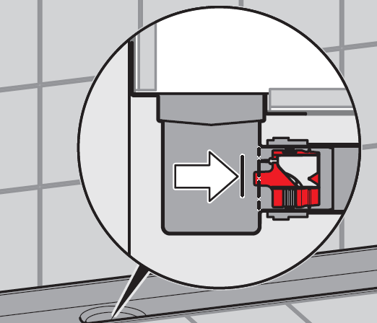
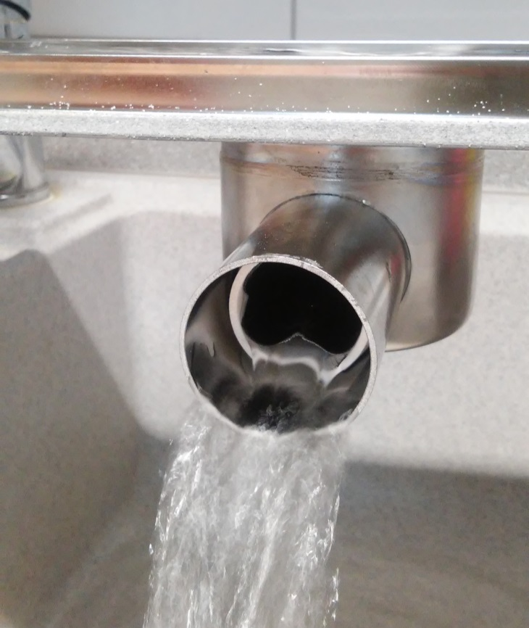
ACO EasyStop usage horizontal outlet
ShowerDrain E, ND 50
ShowerDrain E, ND 40
ShowerDrain C, ND 50
ACO EasyStop

Slide 3
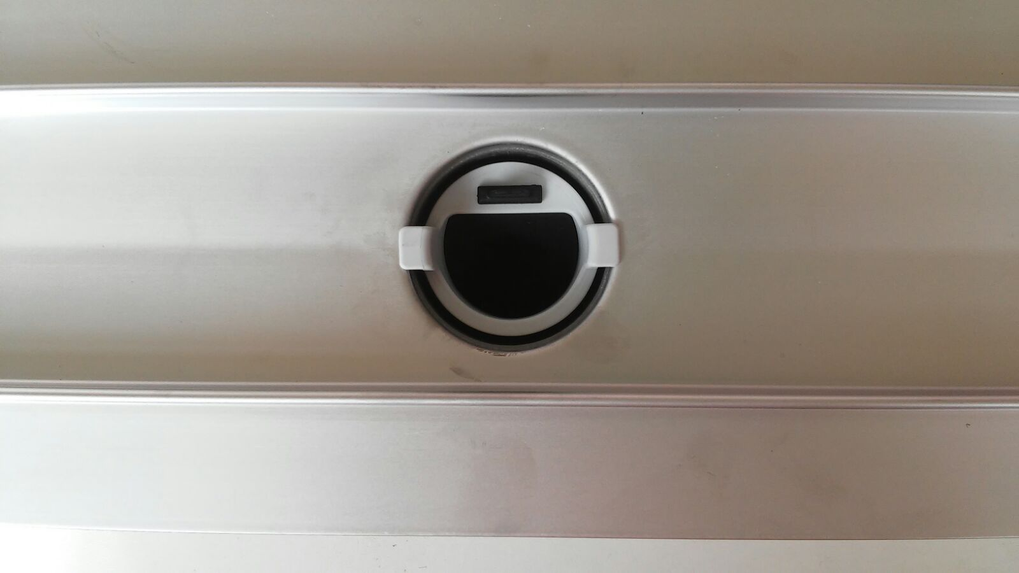
ACO EasyStop usage vertical outlet
ShowerDrain C
ACO EasyStop

Slide 4
ACO EasyStop flow rates
Product | Flow rate in l/s (20 mm build up)
ShowerDrain E, horizontal ND 50 | 0,6
ShowerDrain E, horizontal ND 50, with EasyStop | 0,4
ShowerDrain E, horizontal ND 40 | 0,6
ShowerDrain E, horizontal ND 40, with EasyStop | 0,3
ShowerDrain C, horizontal ND 50 | 0,9
ShowerDrain C, horizontal ND 50, with EasyStop | 0,42

