Slide 1
Grease Separators from ACO Haustechnik
Matthias Jäger Product Management Treatment Systems ACO Haustechnik
Notes:
See next slide!

Slide 2
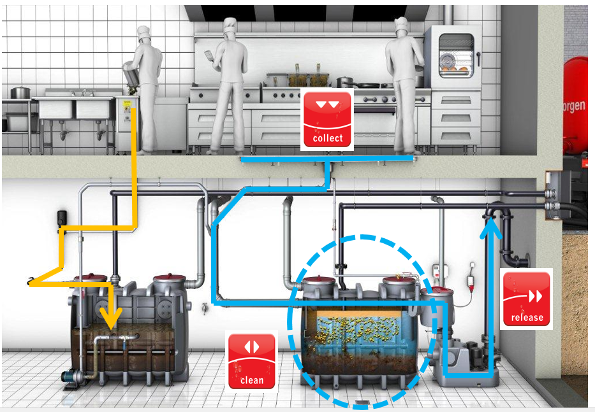
Field of Activity

Slide 3
Headline, Verdana Fett 20 P. Maximal zwei Zeilen. Zeilenabstand 1,1 Zeilen.
Agenda
Notes:
3

Slide 4
Agenda
Greasy waste water: the origin and problems
Function, operation, disposal and advantages of grease separators
ACO grease separators: product portfolio (full disposal)
ACO grease separators: product portfolio (partial disposal)
Certifications, product monitoring and approvals
References

Slide 5
Headline, Verdana Fett 20 P. Maximal zwei Zeilen. Zeilenabstand 1,1 Zeilen.
Greasy Waste Water: the origin and problems
Notes:
5

Slide 6
The Origin of Greasy Waste Water
In commercial kitchens (special case “slaughterhouses”) of restaurants, hotels, universities, hospitals and enterprises greasy waste water is produced during:
Food Preparation
Cleaning of the Kitchen Equipment
Dishwashing

Slide 7
Headline, Verdana Fett 20 P. Maximal zwei Zeilen. Zeilenabstand 1,1 Zeilen.
Fats, Oils and Grease (FOG)
from animals and vegetables can cause severe problems with the drainage systems.
Notes:
7

Slide 8
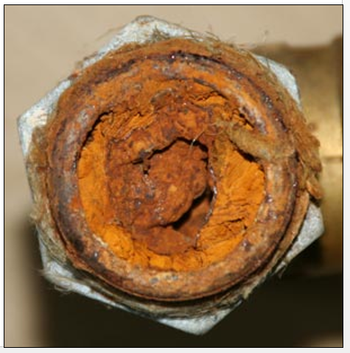
The Problems with Greasy Waste Water #1
The piping of the building can get clogged due to heavy sedimentation with grease.
Effects:
The operation in the kitchen (or the slaughterhouse) must be stopped.
Significant funds and time have to be invested to clean the pipes or (in the worst case) to replace defective piping systems.

Slide 9
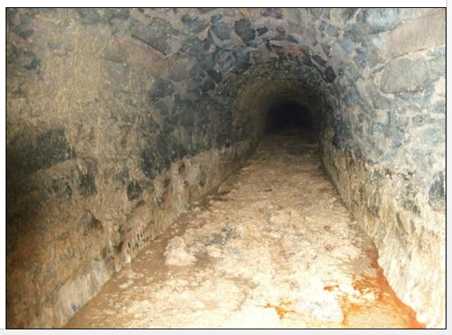
The Problems with Greasy Waste Water #2
If greasy waste water reaches public sewage systems, then grease will also sediment there.
Effect:
Local authorities have to allocate high amounts of tax payer’s money to maintain the public sewer.

Slide 10
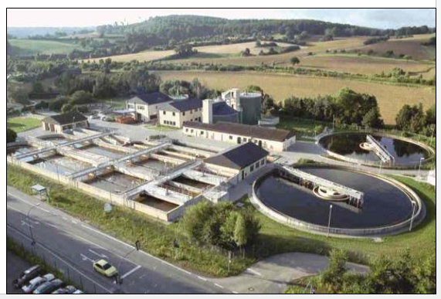
The Problems with Greasy Waste Water #3
If greasy waste water reaches municipal wastewater treatment plants, then the grease will cause malfunction of the entire plant.
Effect:
Local authorities have to allocate high amounts of tax payer’s money to maintain the municipal wastewater treatment plants.

Slide 11
Headline, Verdana Fett 20 P. Maximal zwei Zeilen. Zeilenabstand 1,1 Zeilen.
Function of Grease Separators
Notes:
11

Slide 12
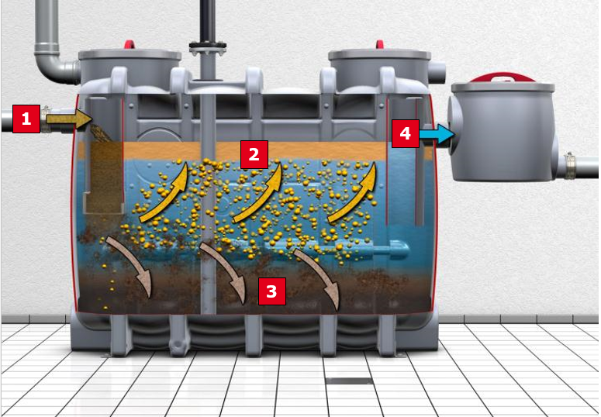
Grease Separators: Gravity Separation
1. Influent with fats, oils and grease
2. Fats, oil and grease float up to the surface
3. Solids will sediment on the bottom
4. Cleaned effluent can be discharged into the sewage system

Slide 13
Headline, Verdana Fett 20 P. Maximal zwei Zeilen. Zeilenabstand 1,1 Zeilen.
Overall Advantages of Appliance of Gravity Grease Separators
Notes:
13

Slide 14
Overall Advantages of Gravity Grease Separators #1
Stakeholders need no regular investment on drainage repairs since pipe system remain in good condition
Clean Sewage Pipe
Save Money
Notes:
14

Slide 15
Overall Advantages of Gravity Grease Separators #2
Remarkable reduction of valuable drinking water consumption for
cleaning/maintenance of both private and public drainage systems
Notes:
15

Slide 16
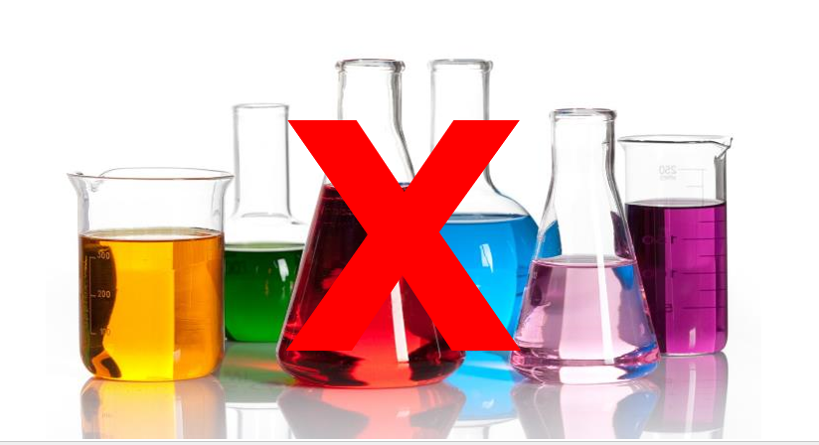
Overall Advantages of Gravity Grease Separators #3
No biohazards through chemicals used in dosing systems which can
cause malfunction in the municipal wastewater treatment plants or pollute
drinking water
Notes:
16

Slide 17
Headline, Verdana Fett 20 P. Maximal zwei Zeilen. Zeilenabstand 1,1 Zeilen.
ACO Grease Separators:
Systems for Complete Disposal

Slide 18
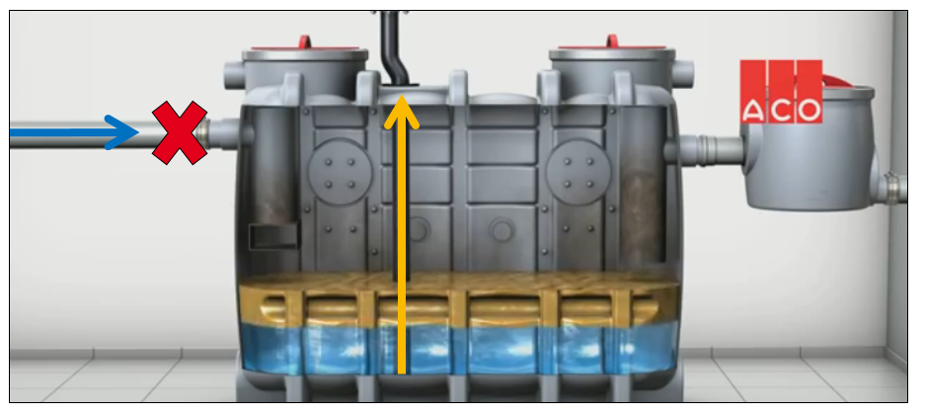
Grease Traps according to EN 1825: Operation/Complete Disposal
Disposal process to be accomplished during non-required time
Recycling truck with vacuum pump needed
Notes:
18

Slide 19
Grease Traps according to EN 1825: Operation/Complete Disposal
Disposal process to be accomplished during non-required time
Recycling truck with vacuum pump needed
Lipator
Notes:
19

Slide 20
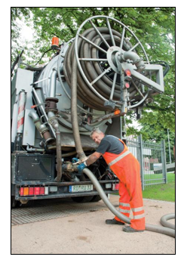
Grease Separators according to EN 1825: Operation/Complete Disposal
Correct sized grease separators have to be emptied and cleaned at least every four weeks
In accordance with local codes, the appliance of grease level sensors may be allowed to enable “disposal on requirement”
Notes:
20

Slide 21
Headline, Verdana Fett 20 P. Maximal zwei Zeilen. Zeilenabstand 1,1 Zeilen.
Product Range: Full Disposal
Notes:
21

Slide 22
Headline, Verdana Fett 20 P. Maximal zwei Zeilen. Zeilenabstand 1,1 Zeilen.
Above Ground Installation (Indoor Installation)
Notes:
22

Slide 23
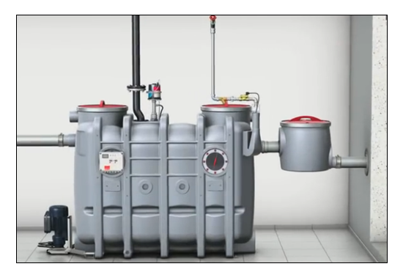
Above Ground (Indoor) Installation: Example

Slide 24
Features and Advantages
Bodies available in four different comfort stages
Separators with structural stability guaranteed for 25 years
Welded Polyethylene
Stainless Steel
Stainless Steel
Rotomoulded Polyethylene

Slide 25
Headline, Verdana Fett 20 P. Maximal zwei Zeilen. Zeilenabstand 1,1 Zeilen.
Below Ground Installation
Notes:
25

Slide 26
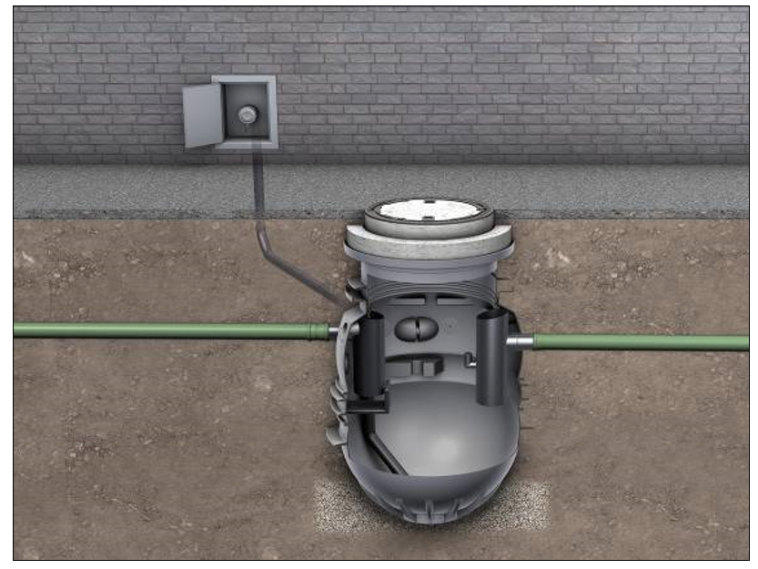
Below Ground Installation: Example

Slide 27
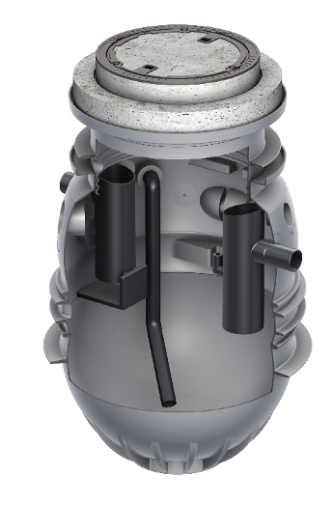
Features and Advantages
Body available in four different comfort stages
Structural stability guaranteed for 50 years

Slide 28
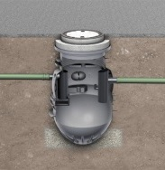
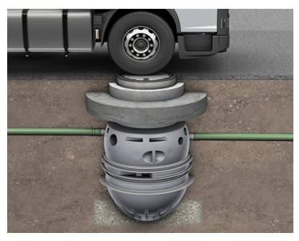
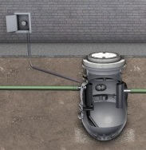
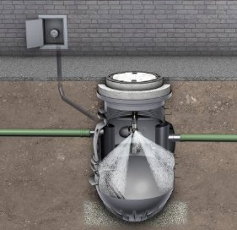
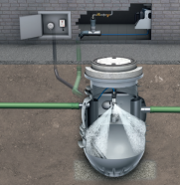
Complete Disposal (Outdoor)
Ground Installation
Lipumax P-B:
The basic version
Lipumax P-D:
Direct suction
Lipumax P-DM:
Manual high-pressure cleaning
Material: polyethylene
Nominal sizes: 1-10
Lipumax P-DA:
Automaded high-pressure cleaning
4 Comfort stages

Slide 29
Headline, Verdana Fett 20 P. Maximal zwei Zeilen. Zeilenabstand 1,1 Zeilen.
Systems for Partial Disposal

Slide 30
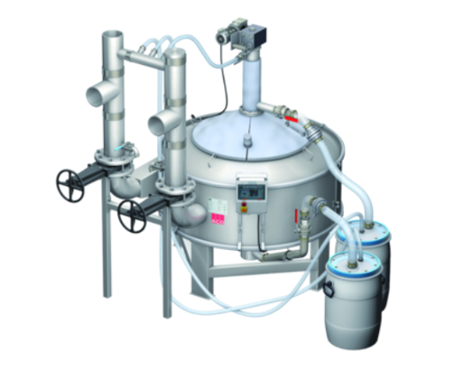
Grease Traps according to EN 1825: Operation/Partial Disposal
Extraction of grease and sludge in separate barrels
Filled barrels have to be replaced with empty ones; this may be necessary every 1 – 2 weeks according to the fill levels and size of the separators
Notes:
30

Slide 31
Headline, Verdana Fett 20 P. Maximal zwei Zeilen. Zeilenabstand 1,1 Zeilen.
Location of Production
Notes:
31

Slide 32
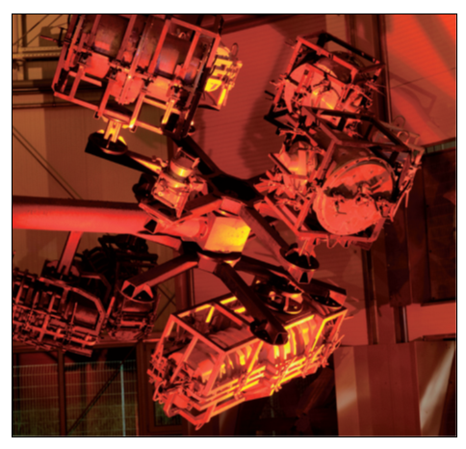
Location of Production
Production in Stadtlengsfeld, Germany:
grease separators from polyethylene
Rotomoulding System:
step: heating
step: cooling

Slide 33
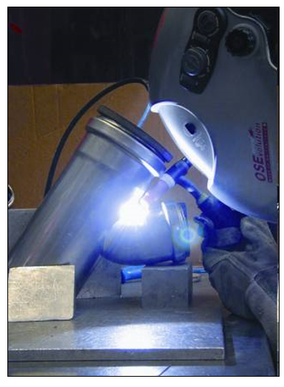
Location of production
Production in Phillipsthal, Germany:
grease separators from stainless steel
after manufactering the grease separators, the final assembly of the inner fitting or pumps takes place also in Stadtlengsfeld

Slide 34
Headline, Verdana Fett 20 P. Maximal zwei Zeilen. Zeilenabstand 1,1 Zeilen.
Certification, Product Monitoring & Approvals
Notes:
34

Slide 35
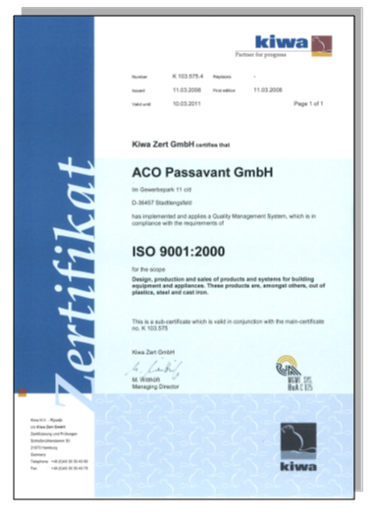
Certification Well Organisized Process Sequences
The location of production is regularily and voluntarily
certificated according to EN ISO 9001:2000.

Slide 36
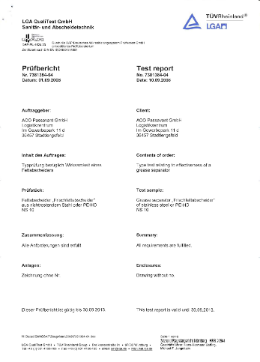
Product Monitoring & Approvals
All grease separators series are type tested for efficiency according to EN 1825

Slide 37
Headline, Verdana Fett 20 P. Maximal zwei Zeilen. Zeilenabstand 1,1 Zeilen.
Some References…
Notes:
37

Slide 38
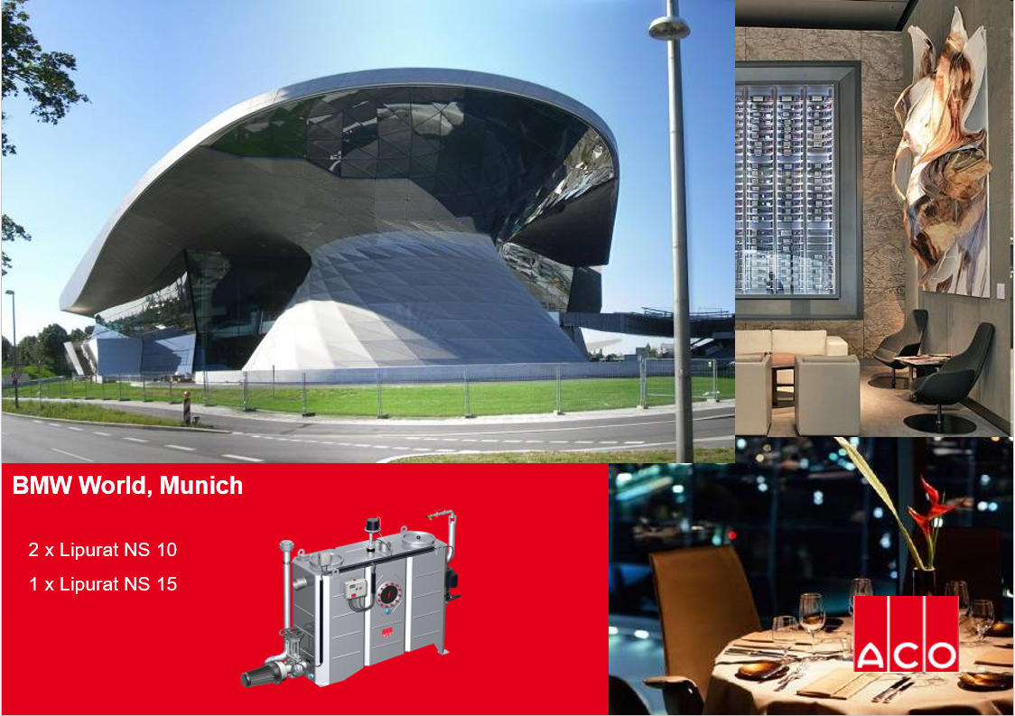

Slide 42
Headline, Verdana Fett 20 P. Maximal zwei Zeilen. Zeilenabstand 1,1 Zeilen.
Questions & answers
Notes:
42

