Slide 1

ACO Haustechnik
Grease separators - planning
Matthias Jäger
Product Management
Grease Separators & Process Engineering

Slide 2
DIMENSIONING

Slide 3
Regulations for Grease Separators
EN 1825-1
Manufacture standard
Manufacturing principles
and testing of
grease separators
EN 1825-2
Application standard
Dimensioning
Installation
Maintenance

Slide 4
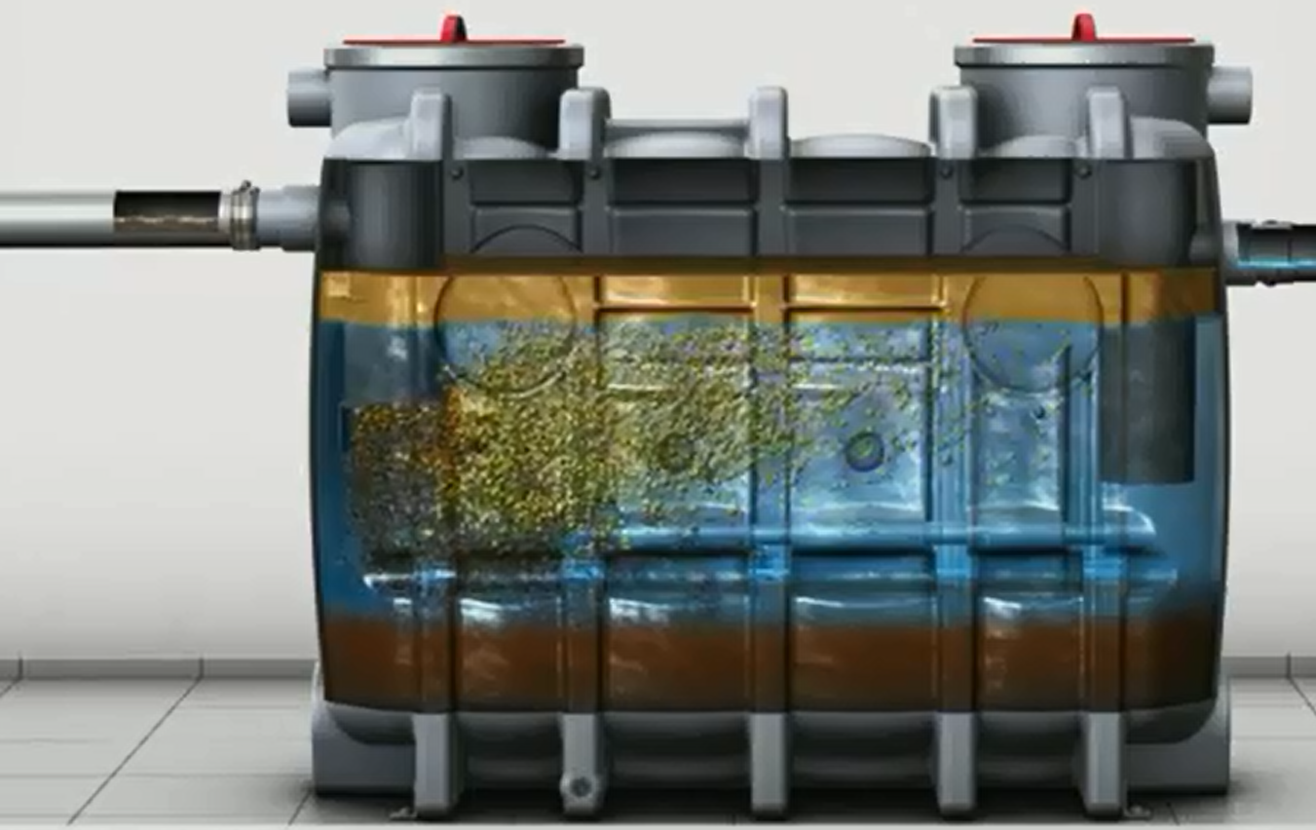
Dimensioning: Determination of Nominal Size
Inlet: Volume rate in l/s determines the nominal size of the grease separator

Slide 5
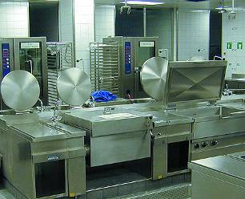
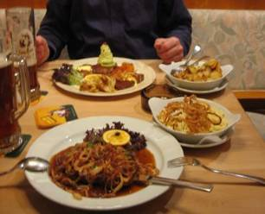
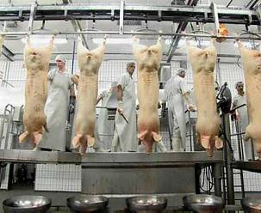
Dimensioning (EN 1825)
European Standard
Types of dimensioning the grease separator
Based on
kitchen equipment
Based on
meals per day
Based on
number of
slaughtered animals

Slide 6
Dimensioning (EN 1825)
European Standard
Based on
kitchen equipment
Based on
meals per day
Based on
number of
slaughtered animals
FLOW RATE (l/s)
DIFFICULTY FACTORS
NOMINAL SIZE (NS)

Slide 7
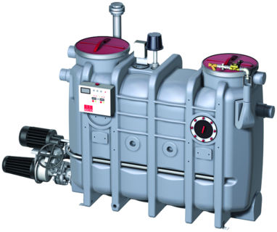
Examples of Dimensioning
Inlet:
Determined Volume rate
2,85 l/s
Inlet:
Determined Volume rate
4,8 l/s
Inlet:
Determined Volume rate
9,3 l/s
Nominal size 3
Nominal size 5,5
Nominal size 10

Slide 8
Headline, Verdana Fett 20 P. Maximal zwei Zeilen. Zeilenabstand 1,1 Zeilen.
1.) Sizing according to produced meals per day
Notes:
8

Slide 9
Dimensioning according to meals per day
Factors:
Type of kitchen
Quantity of produced meals per day
Operating hours

Slide 10


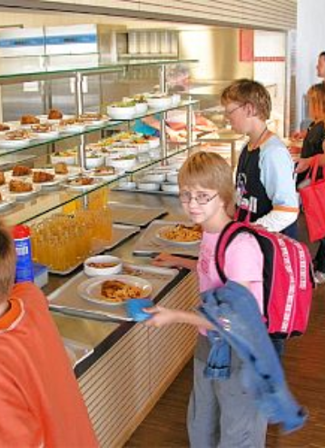

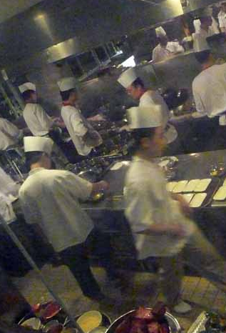
Types of kitchen
EN 1825 defines specific water consumption per warm meal for:
Hotels | Speciality Restaurants | Works‘ kitchen/ refectories | Hospitals | All day large scale kitchens

Slide 11
Type of kitchen
Example: 8 operating hours and 200 meals per day
Hotels | Speciality Restaurants | Works‘ kitchen/ refectories | Hospitals | All day large scale kitchens
l/s

Slide 12
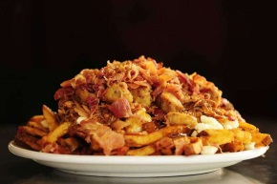
Produced meals per day
According to the formular used in EN 1825, increasing amount of produced meals perday increases the maximum wastewater inflow.

Slide 13
Produced meals per day
Example: 8 operating hours in a hotel kitchen
Maximum wastewater inflow (l/s)
Produced meals per day

Slide 14

Operating hours
According to the formular used in EN 1825, an increasing amount of operating hours decreases the maximum wastewater flow at fixed other conditions (type of kitchen, meals per day)

Slide 15
Operating hours
Example: Hotel kitchen, 200 meals per day
Maximum wastewater inflow (l/s)
Operating hours per day

Slide 16
Headline, Verdana Fett 20 P. Maximal zwei Zeilen. Zeilenabstand 1,1 Zeilen.
Difficulty factors
Notes:
16

Slide 17
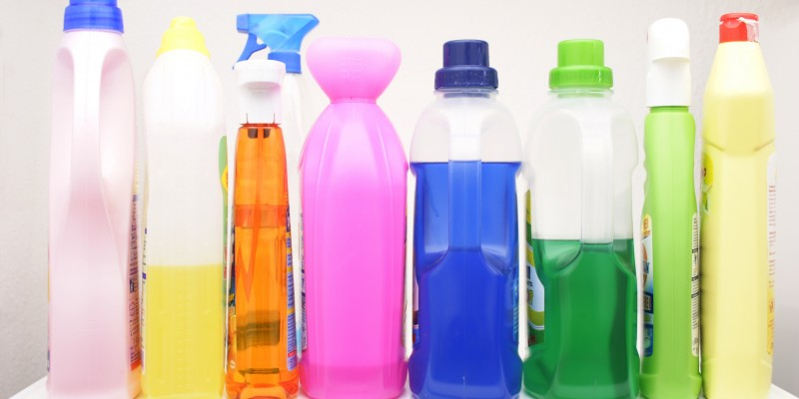
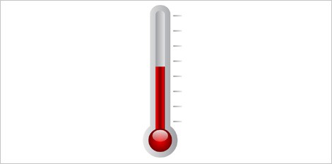
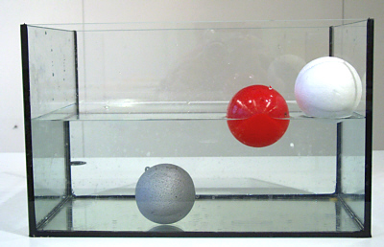
Types of Difficulty factors
According to EN 1825 there exits THREE different difficulty factors:
Cleaning Agents
Temperature
Density of grease
All these factors reduce the separation effect

Slide 18

Difficulty factor: Cleaning Agents
Application of difficulty factor for cleaning agents according to
EN 1825:
Application of cleaning agents | Difficulty factor
No application | 1,0
Application in commercial kitchens | 1,3
Application in hospitals | 1,5

Slide 19
Difficulty factor: temperature
Application of difficulty factor for temperature according to EN 1825:
Temperature of kitchen wastewater | Difficulty factor
Below 60 °C | 1,0
Above 60 °C | 1,3

Slide 20
Difficulty factor: density of cooking oil
Application of difficulty factor for density according to EN 1825:
Density of grease or oil | Difficulty factor
Up to 0.94 g/cm³ | 1,0
Above 0.94 g/cm³ | 1,3

Slide 21
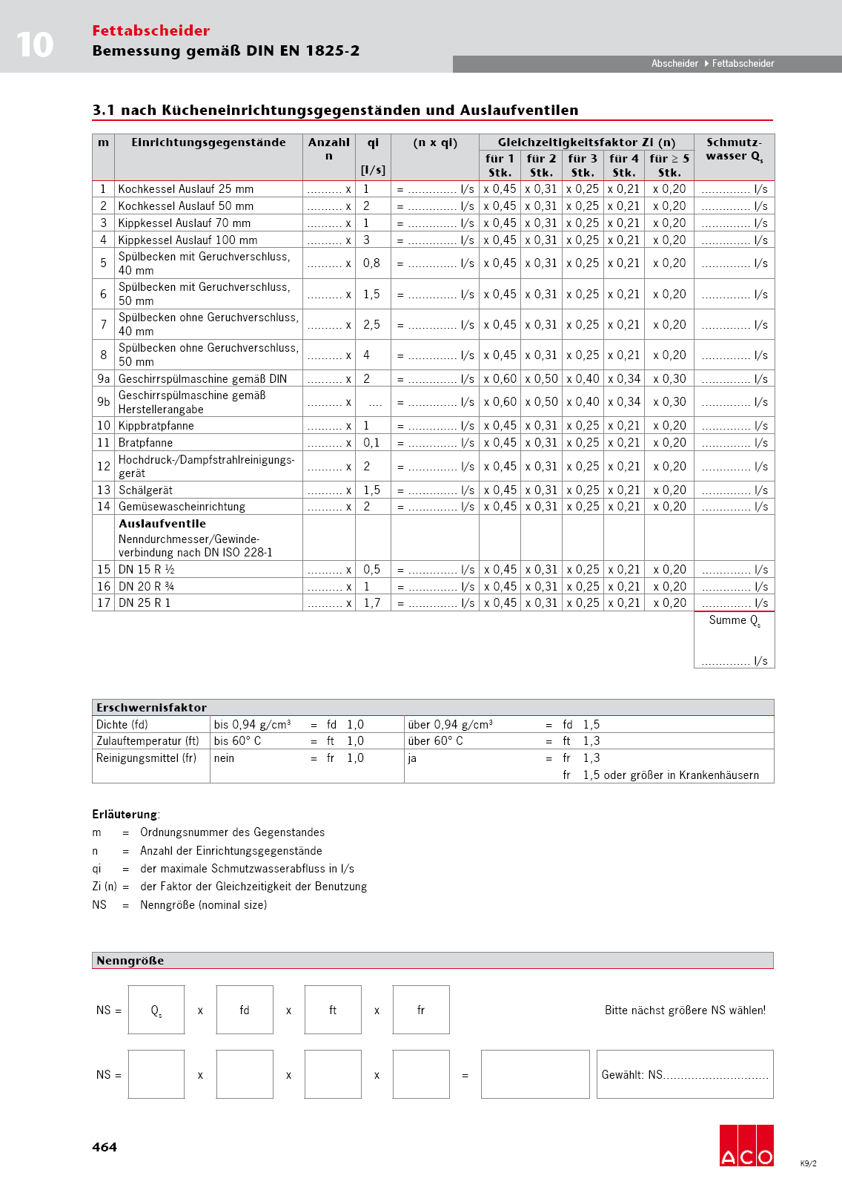
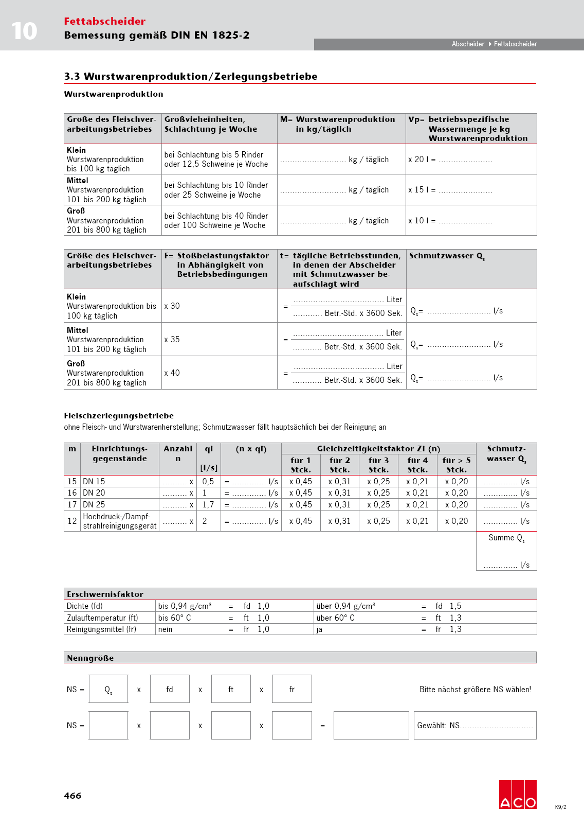
Dimensioning according to EN 1825
Example: Meals per day
160 Meals per day
6 kitchen operating time
Type of kitchen: Hotel
Density of grease: > 0,94 g/cm³
Inlet temperature < 60°C
Use of cleaning agents: yes

Slide 22
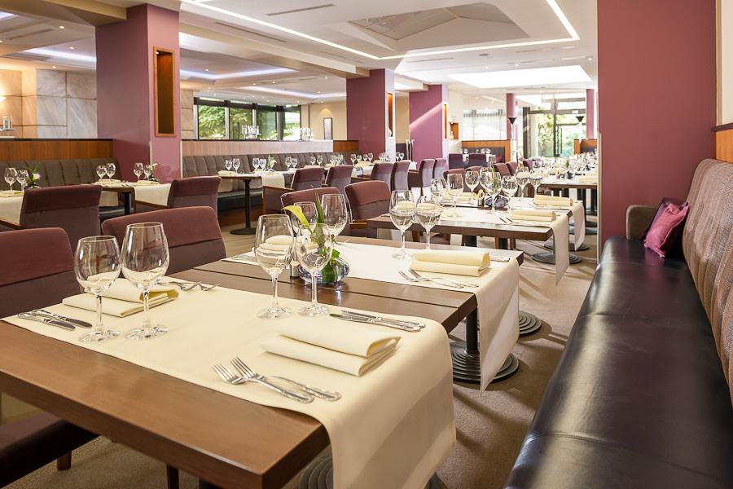
Further Information
Useful Remarks:
No information about the meals per day ?
Maybe you can get some information about the amount of seats !

Slide 23
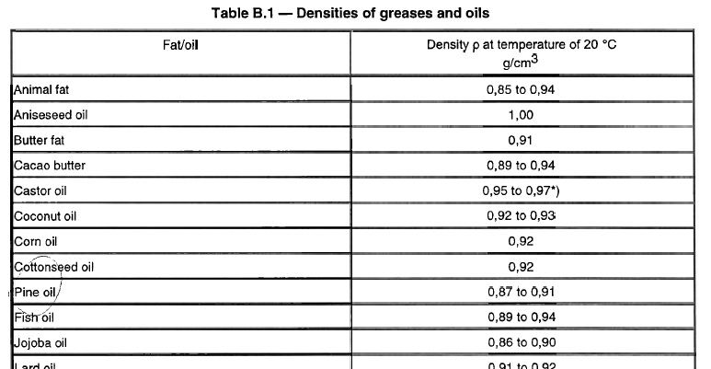
Further Information
Useful Remarks:
No information about the
density of the grease ?
EN 1825-2 appendix B includes table with density values of selected fats
and oils.

Slide 24
Headline, Verdana Fett 20 P. Maximal zwei Zeilen. Zeilenabstand 1,1 Zeilen.
2.) Sizing according to kitchen equipment
Notes:
24

Slide 25
Dimensioning according kitchen equipment
Factors:
Type of equipment
Quantity of each specific equipment

Slide 26
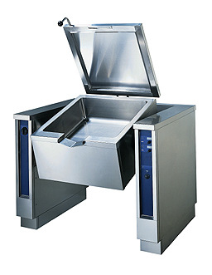
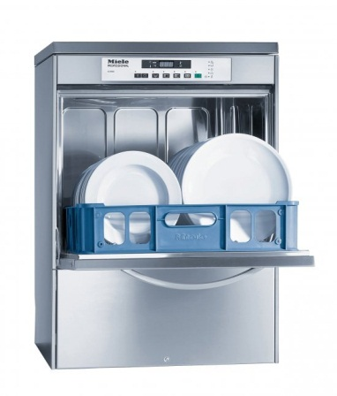
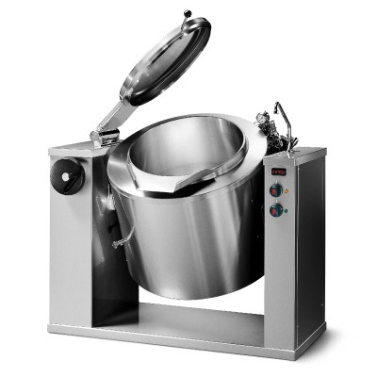
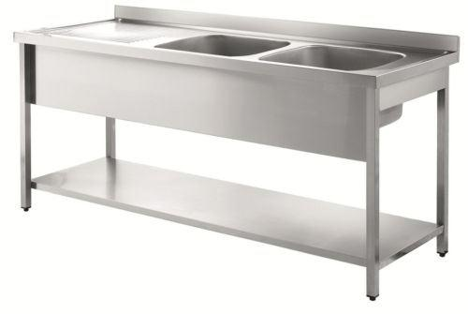
Dimensioning according to kitchen equipment
EN 1825 defines qi value and factors for simultanous operation:
Rinse sinks | Dish washers | Tilting frying pans | Tilting boiling pans

Slide 27
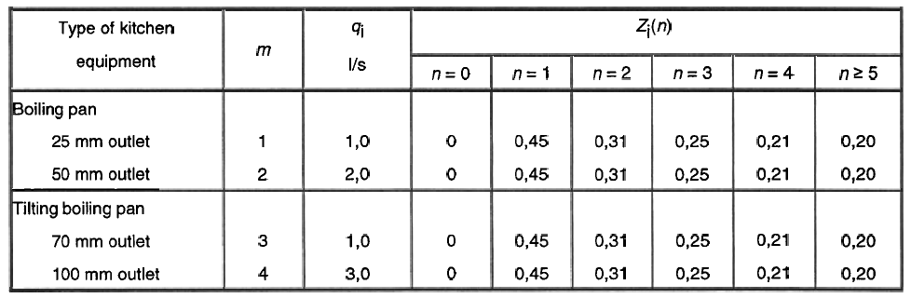
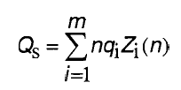
Dimensioning according to kitchen equipment
Example: Tilting boiling pan, outlet with 100 mm, 4 items
= 2,52 l/s

Slide 28
Headline, Verdana Fett 20 P. Maximal zwei Zeilen. Zeilenabstand 1,1 Zeilen.
Selection of Nominal Sizes (NS)
Notes:
28

Slide 29
Further Information
Useful Remarks I:
NS 4
NS 10
According to calculation you
need a NS 4 but…
…you choose NS 10 to delay
disposal time
Grease and sludge will become hard during the „saved“ weeks.

Slide 30
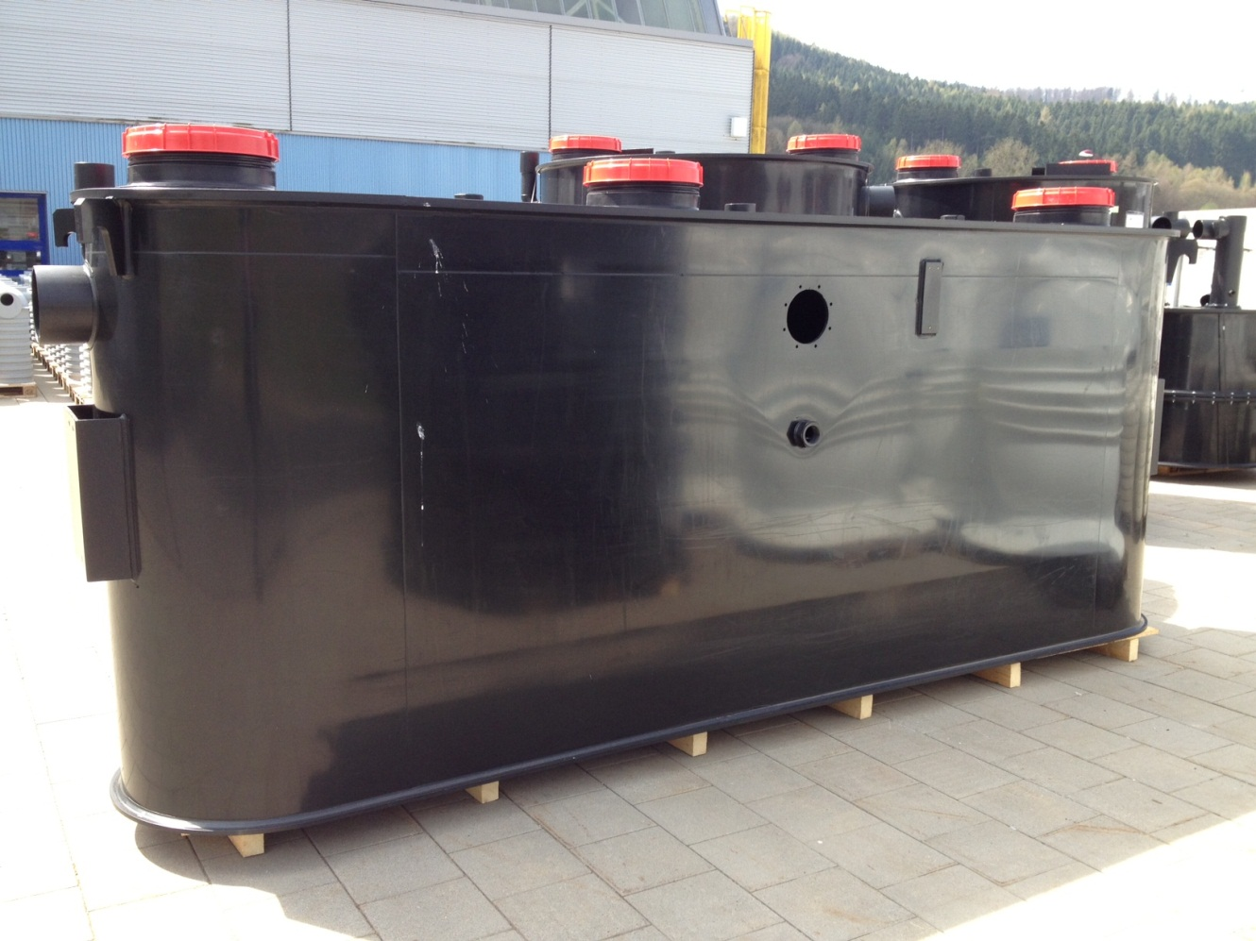
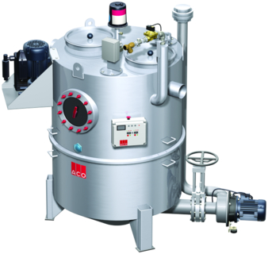
Further Information
Useful Remarks II:
>NS 20 manunfactured from PE plates (welded)
>NS 20 manunfactured from stainless steel

Slide 31

Further Information
Useful Remarks III:
NS | 1 | 2 | 3 | 4 | 5.5 | 7 | 8.5 | 10 | 15 | 20
 |  |  | X |  | X |  | X
Competitors
We also offer Nominal Sizes 3, 5.5 and 8.5.
May be you can quote against a competitor that doesn‘t offer that sizes ☺

Slide 32
Headline, Verdana Fett 20 P. Maximal zwei Zeilen. Zeilenabstand 1,1 Zeilen.
Further questions ?
Notes:
32

