Slide 1
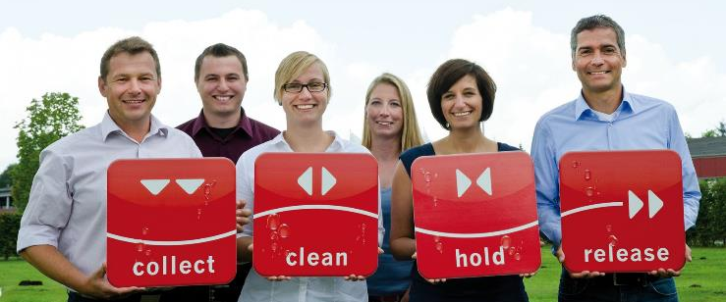
ACO. The future of drainage.
ACO Company Presentation
Author,
Event, location, date

Slide 2
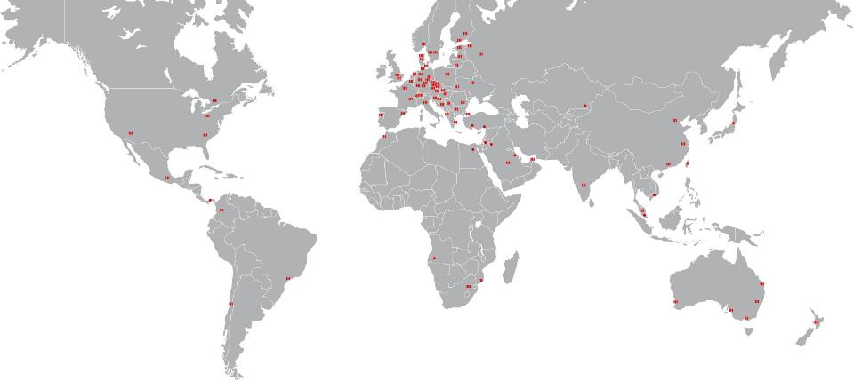
The ACO Group – A Strong Brand Around The World
The ACO Group is one of the world market leaders in
drainage technology for professional drainage,
economical cleaning, and the controlled release and
reuse of water.

Slide 3
ACO. The future of drainage.

Slide 4
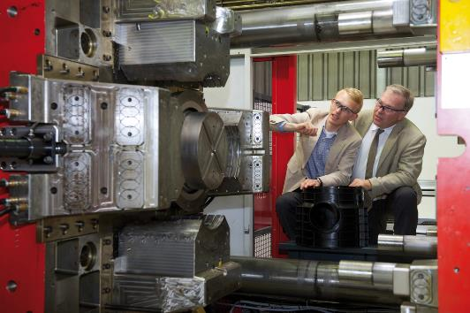
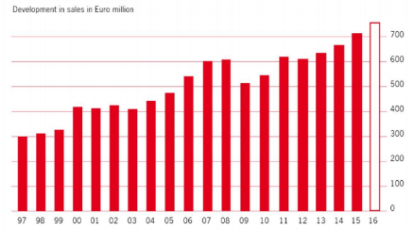
Family Enterprise ACO
1946 company founded by Josef-Severin Ahlmann
4.200 employees in more than 40 countries (Europe, North and South America, Asia, Australia, Africa)
30 production sites in 15 countries
Sales 2015: 705 Mio. Euro
Iver and Hans-Julius Ahlmann (managing partners of the ACO Group) in the plastic production plant in Büdelsdorf

Slide 5
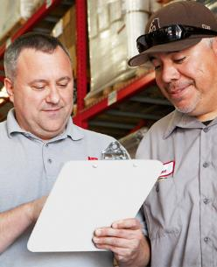
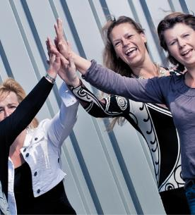
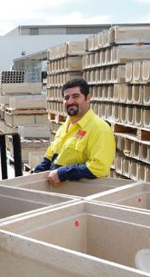
ACO People
The ACO family worldwide includes 3,900 people in 40 countries.
Authenticity, sense of family, and a commitment to strive for peak
performance are the pillars of our corporate culture.

Slide 6
Headline, Verdana Fett 20 P. Maximal zwei Zeilen. Zeilenabstand 1,1 Zeilen.
ACO Mission Statement

Slide 7
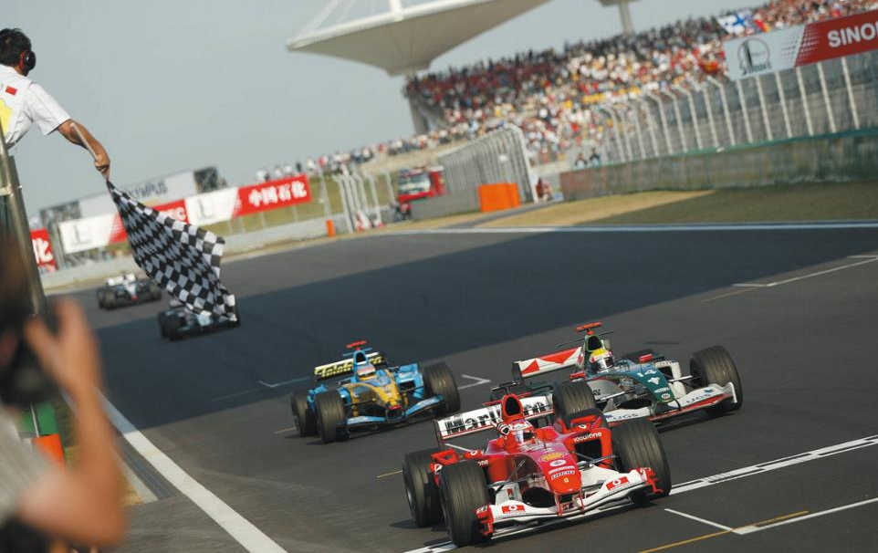
Our Vision
ACO is the world leader in drainage technology
We see our markets through the eyes of our customers.
We like to keep in close contact with them to impress them with the best products and services.

Slide 8
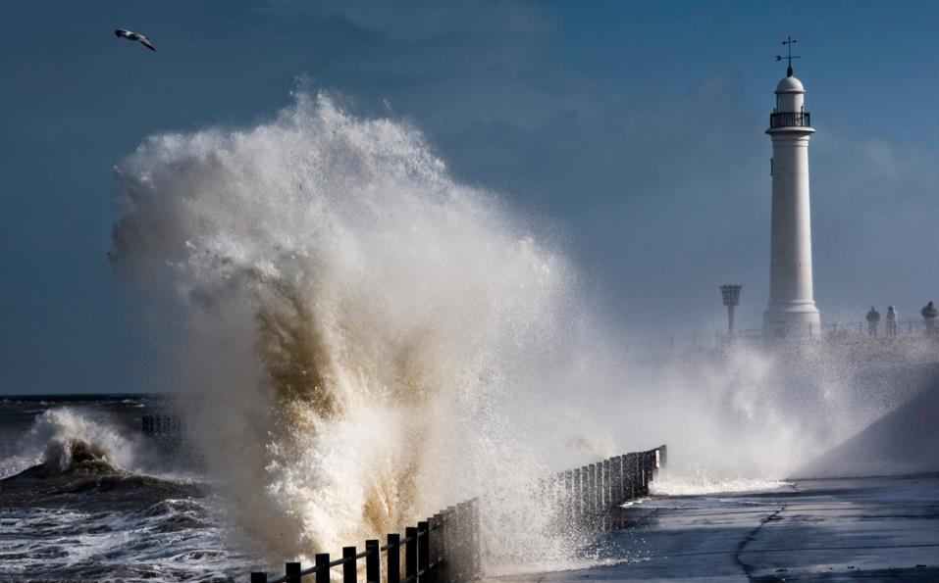
Our Mission
ACO creates solutions for tomorrow‘s environmental conditions
Global climate change is causing more frequent extreme weather events such as droughts and heavy rainfall. We develop innovative system solutions to weather these events.

Slide 9
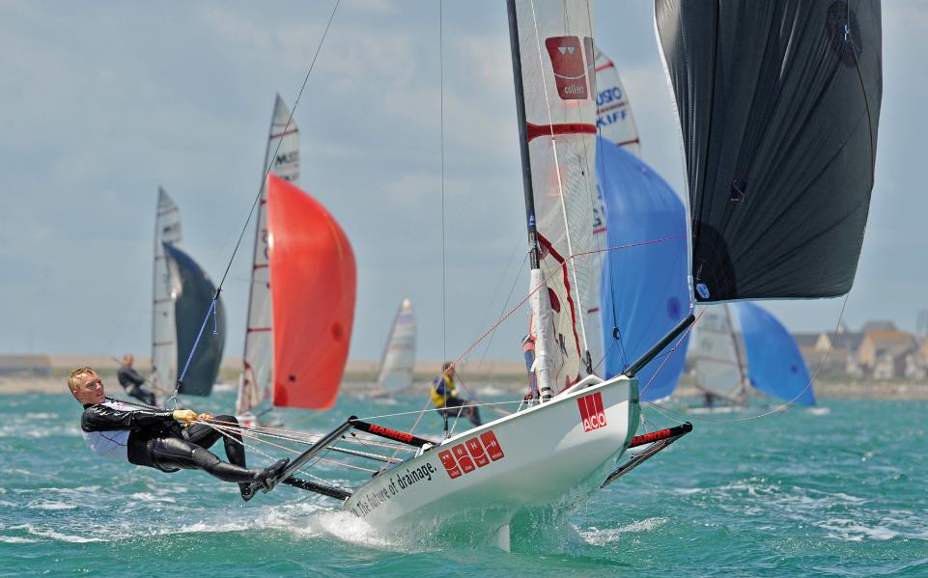
Our Strength
ACO creates a passion for top performance
We support those that act courageously. We enjoy working together creatively across all cultural barriers. In our philosophy, setbacks are an opportunity to become even better.

Slide 10
ACO Mission Statement
Our Vision
Our Mission
Our Strength
ACO is the world leader in drainage technology
ACO creates solutions for tomorrow‘s environmental conditions
ACO creates a passion for top performance
We see our markets through the eyes of our customers. We like to keep in close contact with them to impress them with
the best products and services.
Global climate change is causing more frequent extreme weather events such as droughts and heavy rainfall. We develop innovative system solutions to weather these events.
We support those that act courageously. We enjoy working together creatively across all cultural barriers. In our philosophy, setbacks are an opportunity to become even better.

Slide 11
Headline, Verdana Fett 20 P. Maximal zwei Zeilen. Zeilenabstand 1,1 Zeilen.
Sustainability

Slide 12
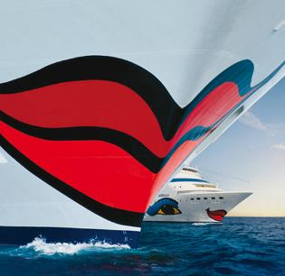
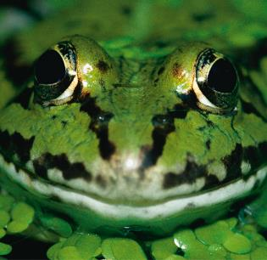
Sustainable Solutions - For People and The Environment
In many vulnerable areas of our lives, ACO product
systems make an important contribution to
environmental protection, the creation and
maintenance of infrastructures, and safety in
industry, commerce and transport.

Slide 13
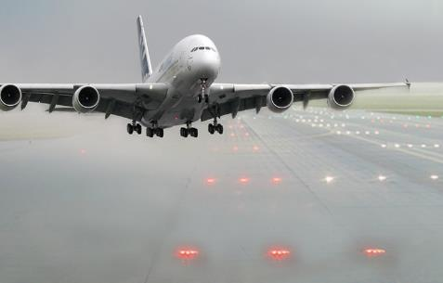
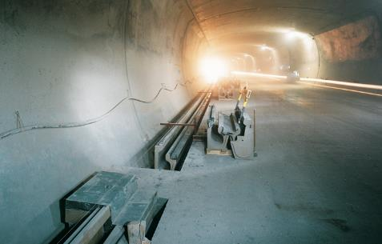
Infrastructure and Drainage – Safeguarding Future Mobility
The expansion, protection and maintenance of transport
routes is one of tomorrow’s key issues, as well as being
one of the biggest infrastructural challenges around the
world. ACO system solutions guarantee the highest
levels of safety on transport and industrial surfaces.

Slide 14
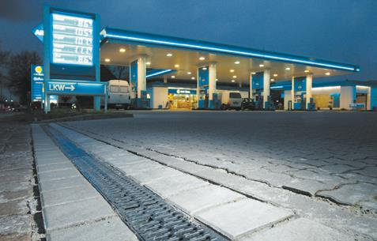
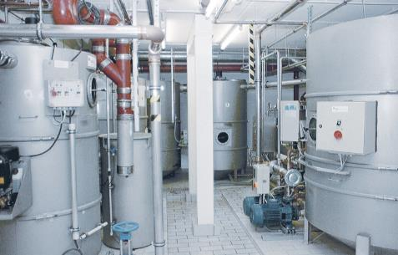
Ecology – Clean Solutions for Our Environment
We look after the practical aspects of environmental
protection, and do our bit to maintain clean water cycles in
industry, commerce and agriculture

Slide 15
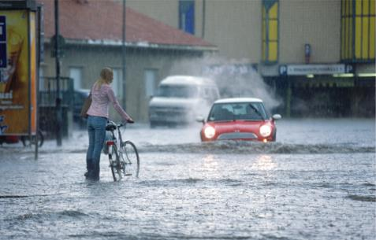
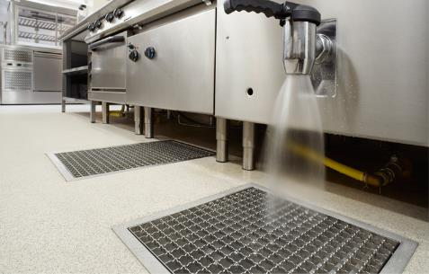
Protection and Hygiene - Highest Levels of Safety for Vulnerable Areas
With our systems for the fast and effective drainage of
building interiors, we help maintain safety and hygiene in
hospitals, industrial kitchens and production facilities.
Our pumps and backflow prevention systems provide
effective protection against flooding or sewer problems.

Slide 16
Headline, Verdana Fett 20 P. Maximal zwei Zeilen. Zeilenabstand 1,1 Zeilen.
Business Field Drainage

Slide 17
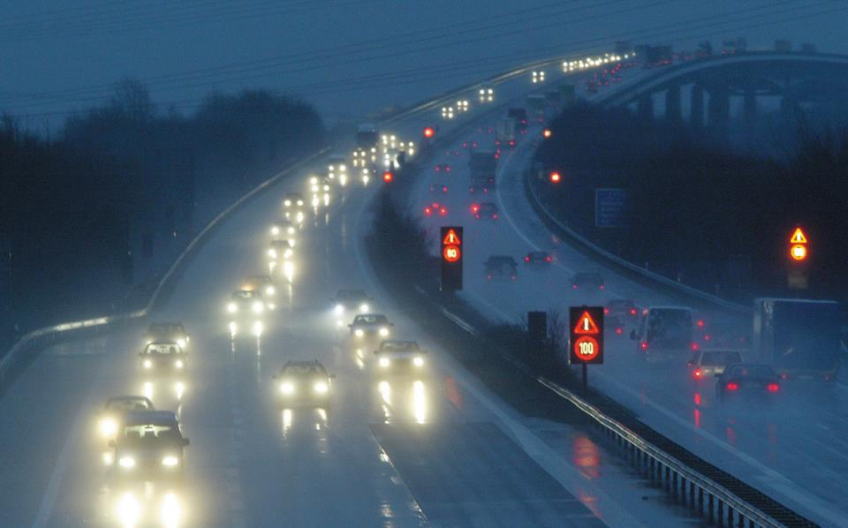
Civil Engineering

Slide 18
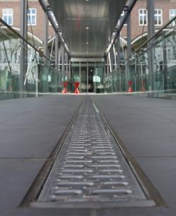
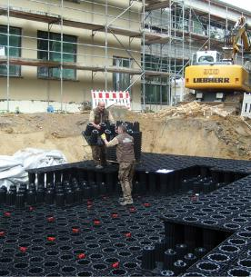
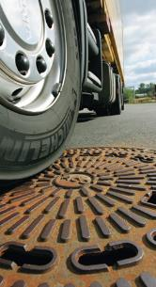
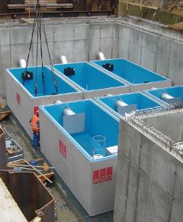
Solutions for Professional Drainage
ACO is a leader in innovative infrastructure solutions. Our systems are used on a huge range of transport sur-faces. Their innovative technologies are oriented to satisfying tomorrow’s more stringent demands: growing traffic levels, changing environmental conditions, re-sponsible water management, and more overall economic efficiency.

Slide 19
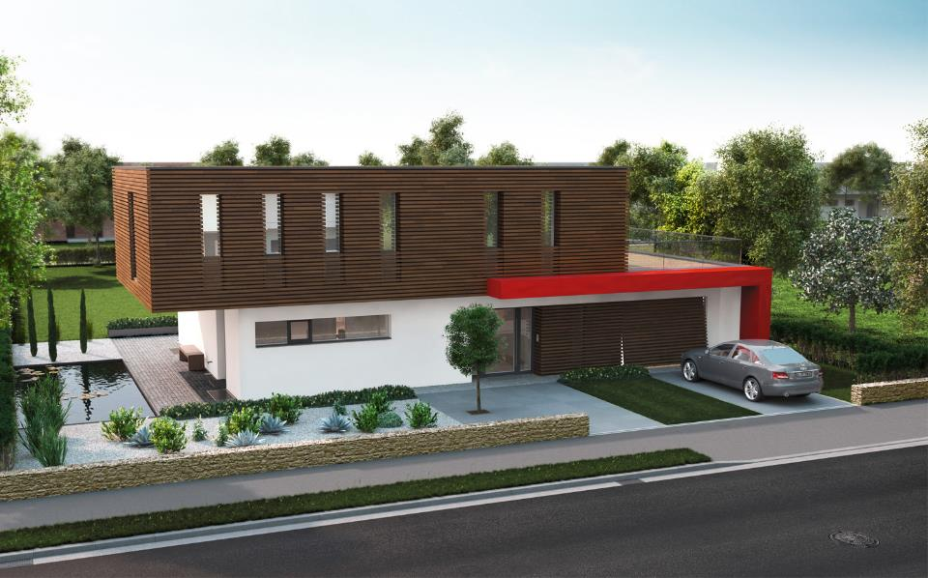
Building Elements

Slide 20
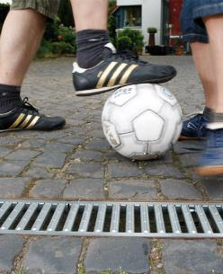
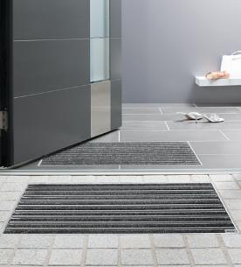
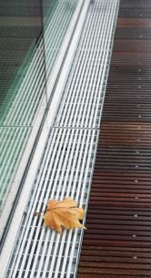
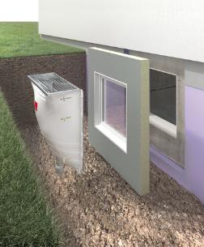
System Solutions for Cellars and Infrastructure all around the House
ACO plays a part in the creation of modern and sustainable
architecture thanks to its protective construction elements
and drainage systems for private and commercial
construction projects –specifically for house, cellar and
garden components.

Slide 21
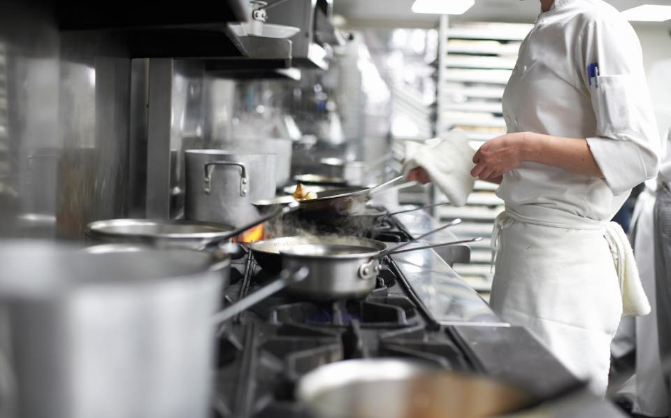
Building Drainage

Slide 22
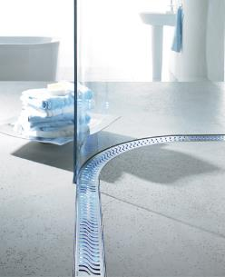
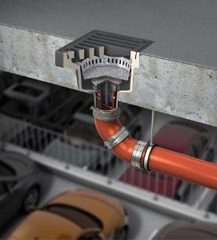
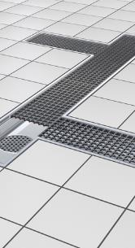
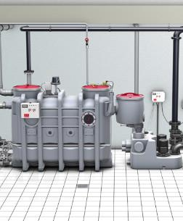
Complete Spectrum for Building Drainage
In its Building drainage division, ACO combines drainage
elements to create sustainable solutions for private homes
and office buildings, as well as for industrial kitchens, hotels
and commercial property.

Slide 23
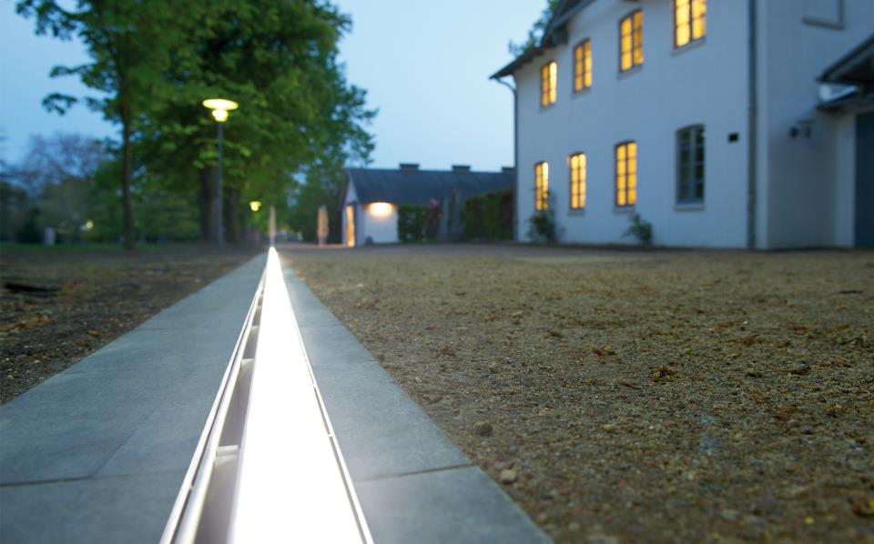
Gardening and Landscaping

Slide 24
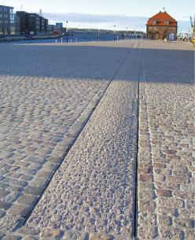
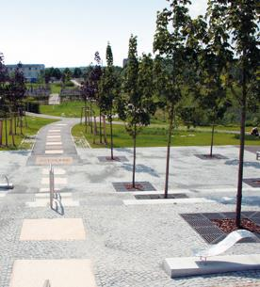
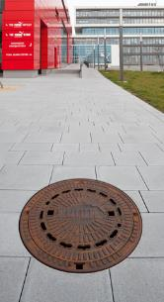
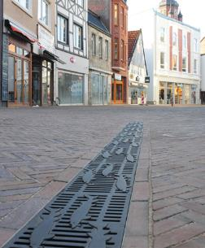
Systems for Gardening and Landscaping
ACO provides professional gardening and landscaping
enterprises with solutions for public open spaces and all
areas around houses. Systems for reliable drainage,
guidance and tree protection provide planners with a wide
spectrum of options for the customised design of outdoor
spaces – from house gardens to Olympic stadiums.

Slide 25
ACO Sport

Slide 26
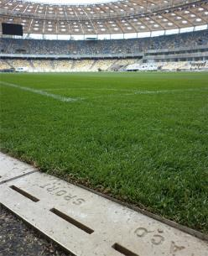
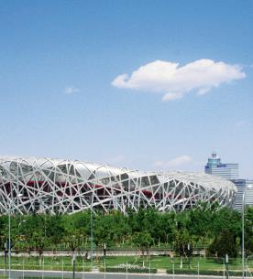
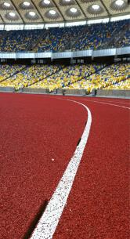
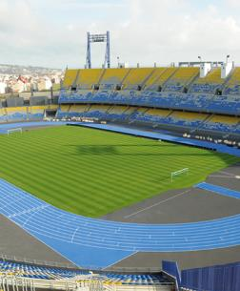
ACO Sport
If athletes are to produce outstanding performances, they
also require optimal conditions. As an experienced sports
arena construction partner, ACO is called on for its
expertise around the world: in almost all Olympic stadiums
built since 1972, as well as numerous council sports
facilities.

Slide 27
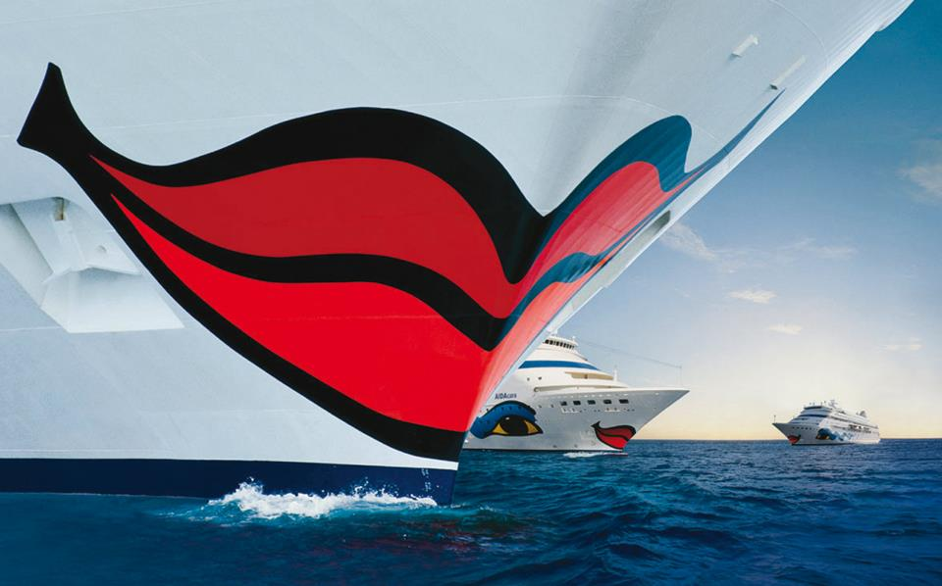
ACO Marine

Slide 28
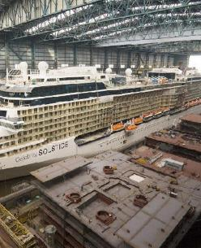
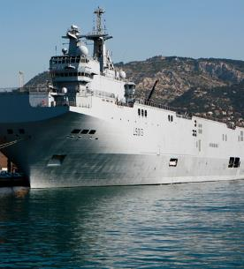
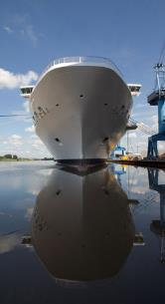
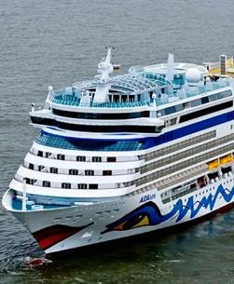
ACO Marine - Innovative Technology for Clean Oceans
Mega yachts, cruise liners, ferries, navy ships, offshore
platforms, and all types of cargo ships are equipped by
ACO Marine with systems for drainage and wastewater
treatment.

Slide 29
Headline, Verdana Fett 20 P. Maximal zwei Zeilen. Zeilenabstand 1,1 Zeilen.
ACO System and Service Chain

Slide 30
ACO System Chain

Slide 31
ACO System Chain
collect:
Gather and capture
clean:
Pre-treat and process
hold:
Retain and contain
release:
Pumping, discharging and reusing

Slide 32
ACO Service Chain

Slide 33
ACO Service Chain
train:
Information and further education
design:
Planning and optimisation
support:
Construction advice and assistance
care:
Inspection and servicing

Slide 34
Headline, Verdana Fett 20 P. Maximal zwei Zeilen. Zeilenabstand 1,1 Zeilen.
ACO Academy

Slide 35
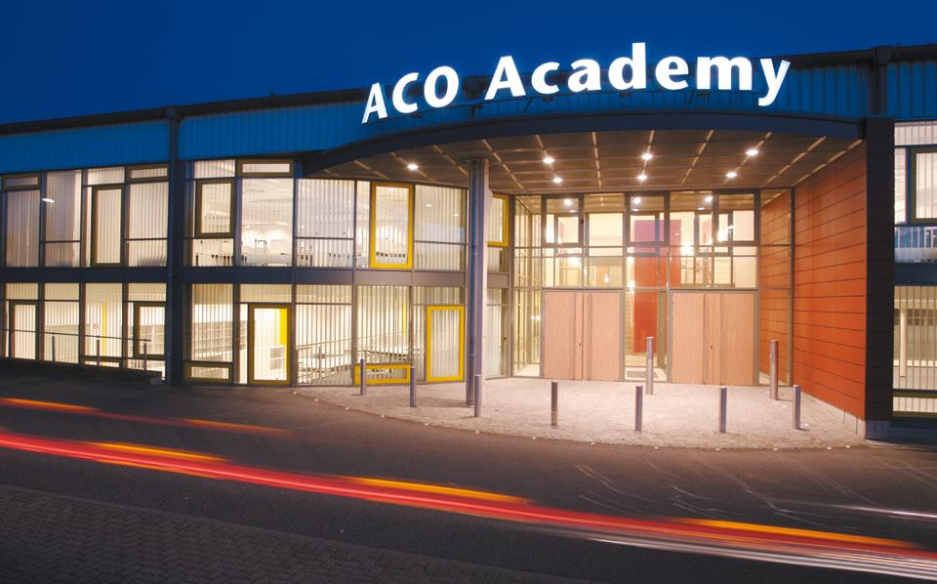
ACO Academy

Slide 36
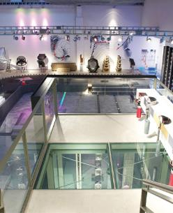
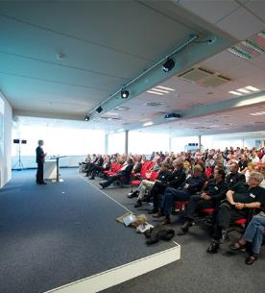
Sharing Knowledge Equals Multiplying Know-How
Another factor behind ACO’s strength: we consider
communication to be a crucial success parameter. With
intense knowledge management, we harness the
opportunities for linking up creativity, know-how and
experience worldwide, and share this expertise with clients
and partners.

Slide 37
Headline, Verdana Fett 20 P. Maximal zwei Zeilen. Zeilenabstand 1,1 Zeilen.
Awards

Slide 38
ACO Awards – Perfection is also a Pleasure
Success and excellent performance in one’s personal sphere
are highly satisfying, but the ultimate prize and the strongest
and most pleasurable motivation factor is being successful in a
team. The ability of the ACO Group, teams and employees to
jointly achieve outstanding results has been proven time and
again in the past.
This is underlined by sales records, quality prizes for the
factories, as well as design and innovation awards.

Slide 39
ACO Awards – Perfection is also a Pleasure
light+building 2012 award for the ACO
Sideline – instalight 1060 for the best overall
concept, design quality and innovation
content
Universal Design Award 2012 for
the ACO Sideline. The second
award following the first in 2010
baustoffmarkt Oscar 2011 as a
strong partner of the German
builder’s merchants sector
Architects‘ Darling Award 2012:
2,500 architects and planners chose ACO
as the best supplier in the drainage
technology sector
tHIS Tiefbau prize 2011
and 2012

Slide 40
ACO Awards – Perfection is also a Pleasure
German Cultural Sponsorship
Prize 2011 for ACO’s in-
volvement in the Kunstwerk
Carlshütte
Award for NordArt as a selected
location in the Land of Ideas 2008
and 2012

Slide 41
Headline, Verdana Fett 20 P. Maximal zwei Zeilen. Zeilenabstand 1,1 Zeilen.
Dedication

Slide 42
Kunstwerk Carlshütte

Slide 43
Kunstwerk Carlshütte

Slide 44
Kunstwerk Carlshütte

Slide 45
Kunstwerk Carlshütte

Slide 46
Kunstwerk Carlshütte

Slide 47
Kunstwerk Carlshütte

Slide 48
Schleswig-Holstein Musik Festival

Slide 49
Schleswig-Holstein Musik Festival

Slide 50
Schleswig-Holstein Musik Festival

