Slide 1
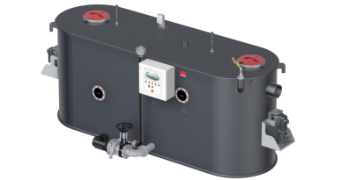
Hydrojet OXL Series
Presented by: Matthias Jäger Shanghai, China
Notes:
See next slide!

Slide 2
Headline, Verdana Fett 20 P. Maximal zwei Zeilen. Zeilenabstand 1,1 Zeilen.
Application
Notes:
2

Slide 3
Hydrojet OXL Series
Oversized grease separators for large scaled projects (catering services, universities, shopping malls)

Slide 4
Headline, Verdana Fett 20 P. Maximal zwei Zeilen. Zeilenabstand 1,1 Zeilen.
Available Sizes
Notes:
4

Slide 5
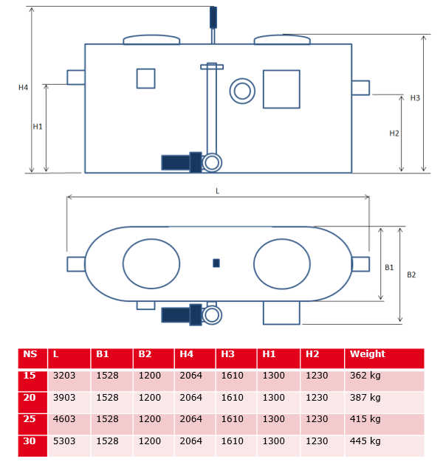
Available Sizes – Maximum Dimensions

Slide 6
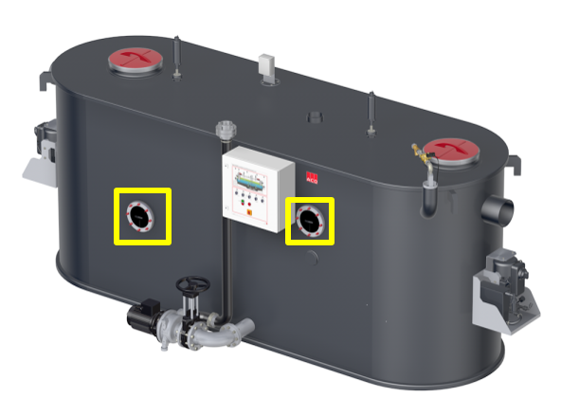
Feature Items
One inspection window for grease level control
One inspection window for sludge level control

Slide 7
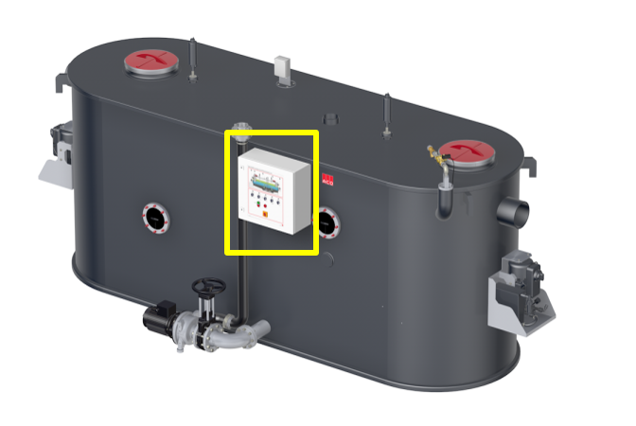
Scope of Delivery – Significant Items
One pre-wired control box with programme preset and ready for plug-in

Slide 8
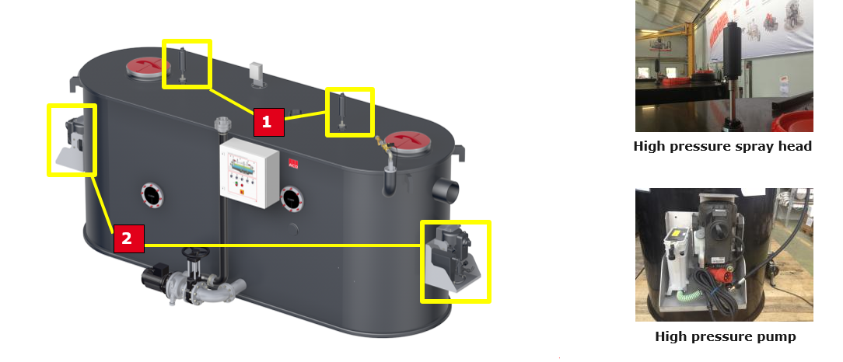
Feature Items
Two high pressure spray heads (1) operated via two high pressure pumps (2)

Slide 9
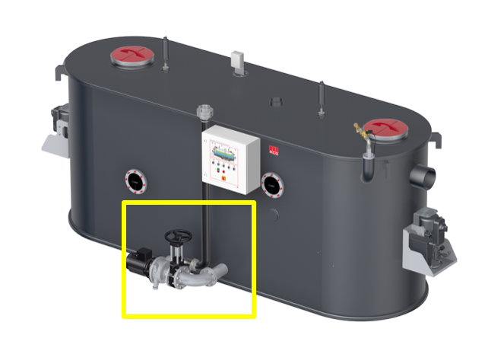
Feature items
One disposal pump for regular empyting

Slide 10
Headline, Verdana Fett 20 P. Maximal zwei Zeilen. Zeilenabstand 1,1 Zeilen.
System Functionality
Notes:
10

Slide 11
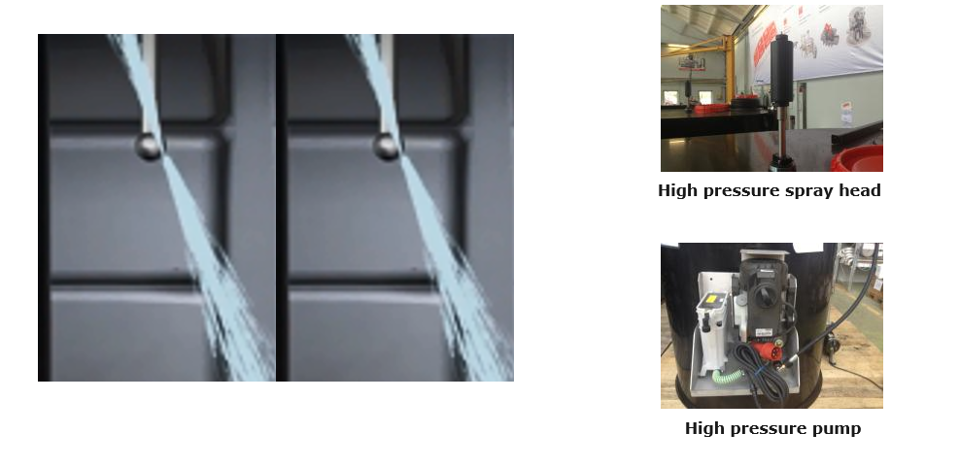
Feature items: High Pressure Cleaning
Two high pressure spray heads (1) operated via two high pressure pumps (2)
Independent operation from disposal pump

Slide 12
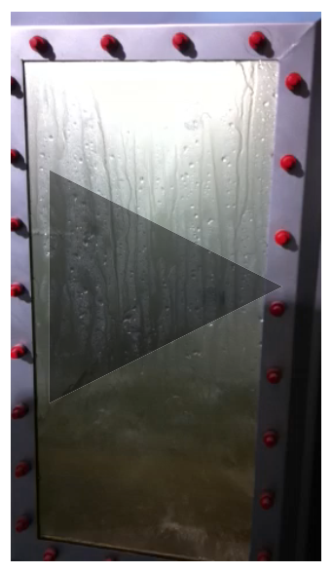
Feature items: High Pressure Cleaning
Nominal max. pressure of pump: 175 bars
Operating pressure of spray head: 150 bars

Slide 13
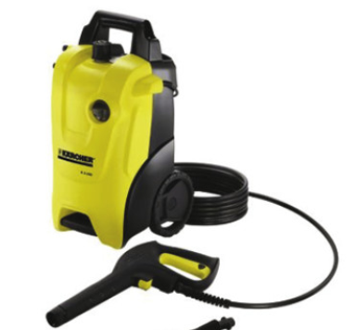
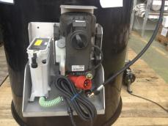
Feature items: High Pressure Cleaning
High pressure pump
Pressure pump is a brand product of Kärcher
Pump is being used for decades in high pressure cleaning devices in millions of high pressure cleaners

Slide 14
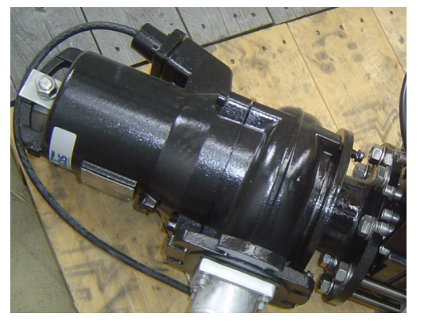
Feature items: High Pressure Cleaning
One disposal pump for regular emptying of separator body
Independent operation from cleaning system
With contrablock cutting system

Slide 15
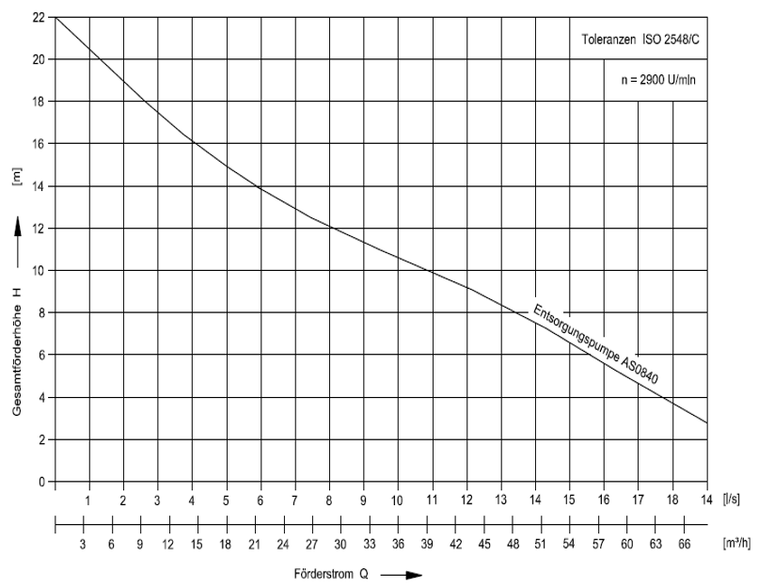
Special Pump AS840 (3,7 kW)

Slide 16
Headline, Verdana Fett 20 P. Maximal zwei Zeilen. Zeilenabstand 1,1 Zeilen.
Two pump systems for two processes
Notes:
16

Slide 17
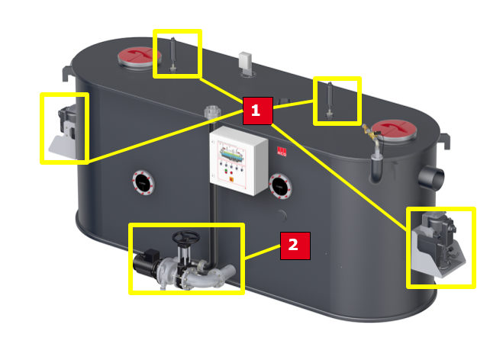
Two Pump Systems for Two Processes
Cleaning system (1) operates independently from disposal system operating with one pump only (2)

Slide 18
Headline, Verdana Fett 20 P. Maximal zwei Zeilen. Zeilenabstand 1,1 Zeilen.
Product and Installation Examples
Notes:
18

Slide 19
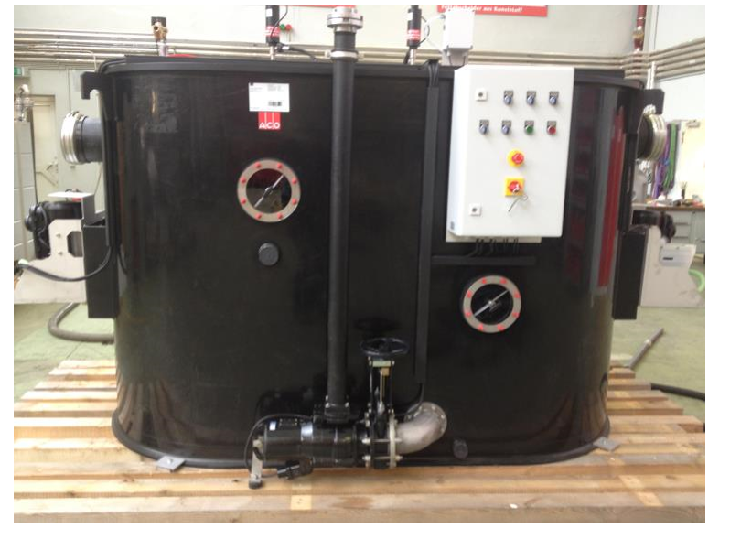
Hydrojet OXL NS 15

Slide 20
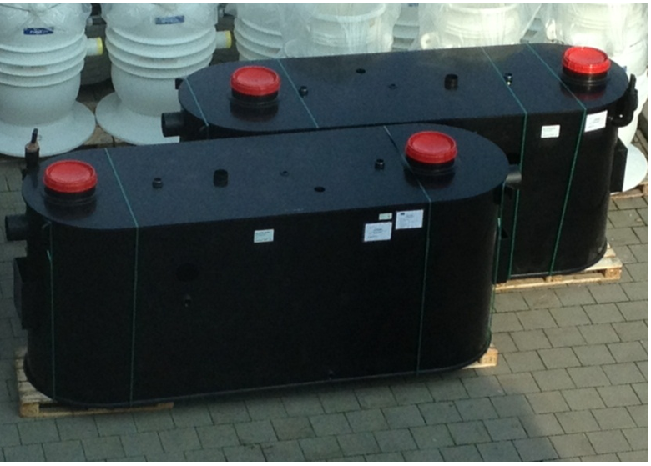
Hydrojet OXL NS 25 (bodies)

Slide 21
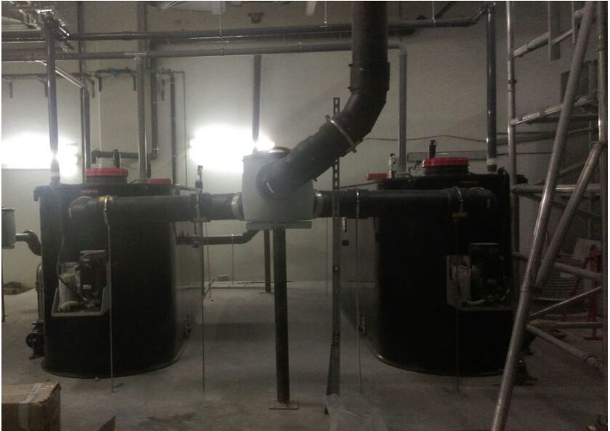
Hydrojet OXL NS 25 x 2 (Installation)

Slide 22
Headline, Verdana Fett 20 P. Maximal zwei Zeilen. Zeilenabstand 1,1 Zeilen.
Q & A
Notes:
22

