Slide 1
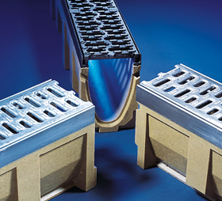
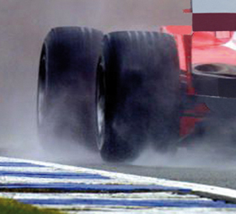
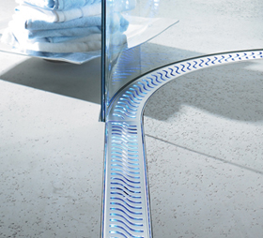
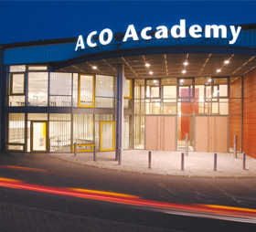
Multiline Polymer Concrete Drain Systems
Benefits of Line Drainage
Polymer Concrete Properties
Combinations and Applications
Gratings and Brickslot
Installation
Sizes and Dimensions
References

Slide 2
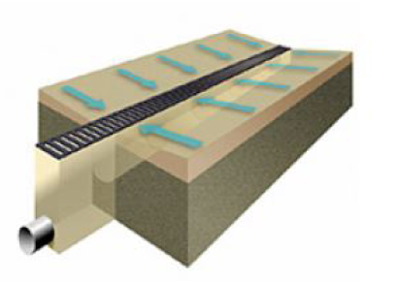
Multiline
Benefits of Line Drainage
Surface drainage systems aim to control surface rainfall run-off by slowing its drainage rate, relieving pressure on sewerage systems and mimicking natural drainage as closely as possible. Efficient surface drainage prevents damage to pavements and properties and reduces safety hazards caused by ponding.
Surface drainage is designed to:
Reduce standing water
Reduce slip hazards and subsequent injury
Protect and extend life of pavements and roadways
Protect property from flood damage
Reduce inconvenience to public users
Reduce hydroplaning on roads

Slide 3
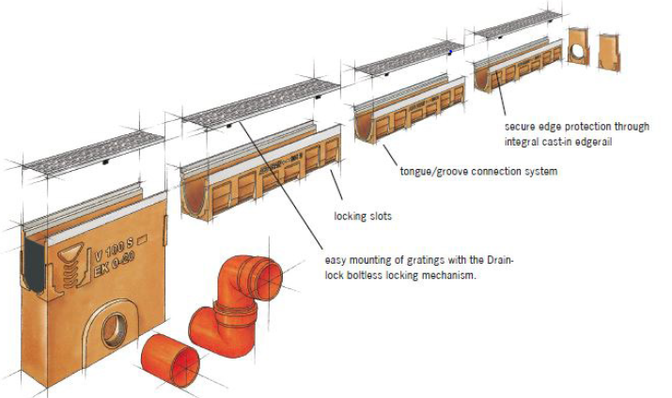
Multiline
Benefits of Line Drainage
Line drainage offers many advantages compared to point drain solutions due to the high drainage capacity and easy installation and maintenance.
Some further advantages are:
• Neat linear appearance
• Simple grades to design and construct
• Easy to install - shallower excavation and easy grading of pavement
• Continuously intercepts water along its length and provides superior drainage
• Minimal need for underground pipes
• Maintenance is quick and easy as trench is at the surface and easier to access

Slide 4
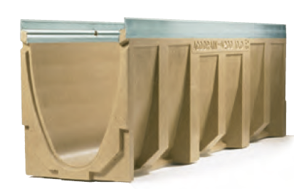
Multiline
Polymer Concrete Properties
What is Polymer Concrete?
Polymer concrete is a versatile highly durable material. It is a mixture of mineral aggregates and resins, which forms a lightweight, corrosion resistant material ideally suited to channel drainage.
Mechanical Properties:
Superior bending tensile strength and compressive strength compared to concrete.
Drainability:
Considerably lower surface roughness and water absorption compared to concrete

Slide 5
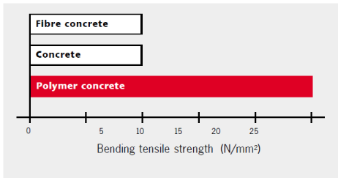
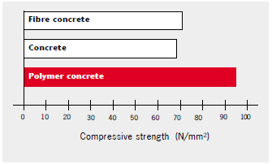
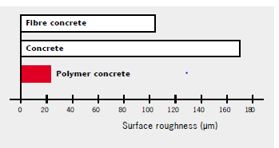
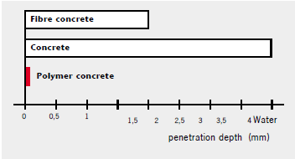
Multiline
Polymer Concrete Properties
Mechanical Properties:
Drainability:

Slide 6
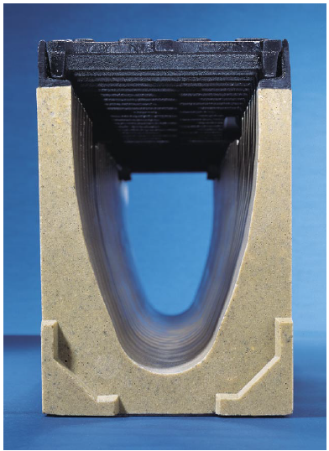
Multiline
Combinations and Applications
Faster flow, more effective cleaning:
The V-profile of the channels in combination with the smooth surface of the ACO polymer concrete produces amazing results:
Faster flow rates
Fast run-off
Optimum self-cleaning effect

Slide 7
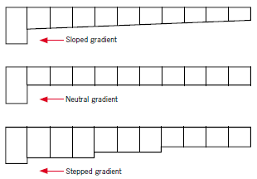
Multiline
Combinations and Applications
Sloped Channels Enhance Water Flow
ACO Multiline drainage systems are suitable for all types of gradients,
from sloped to neutral, and allow different gradient types to be combined.
The conditions for complete drainage of the channel drain are best when the system is installed using sloped channels.
This speeds up the drainage of the water and boosts the self-cleaning effect.

Slide 8
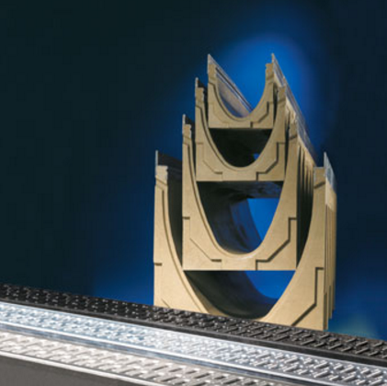
Multiline
Combinations and Applications
Advantages:
Continuous longer sloped channels up to 20 meters in one stretch
Combination of sloped and neutral channels up to 140 meters with single outlet
V100 Drain Channel:
Depth available between 150mm and 250mm
V150 Drain Channel:
Depth available between 210mm and 310mm
Better flow-rate (Discharge) with better velocity

Slide 9
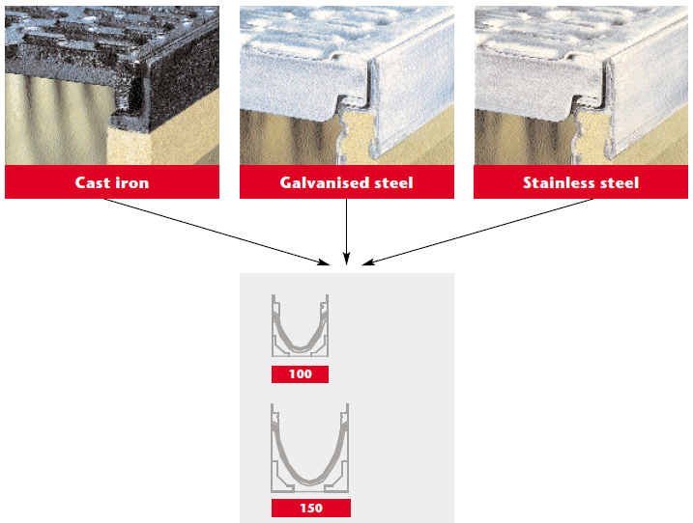
Multiline
Combinations and Applications
Availability:

Slide 10
Multiline
Combinations and Applications

Slide 11
Multiline
Combinations and Applications

Slide 12
Multiline
Combinations and Applications

Slide 13
Multiline
Combinations and Applications
* The mentioned lengths are subjected to the site and local condition. The sloping conditions are applicable only for V 100 and V 150.

Slide 14
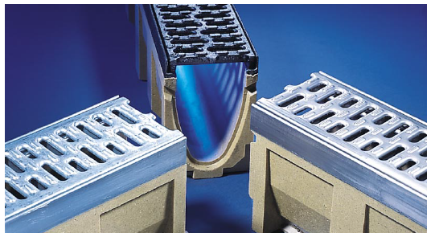
Multiline
Gratings and Brickslot
Grating covers for every application
The ACO Multiline system solution has a simple range of different gratings suitable for most architectural requirements in terms of aesthetics, functionality and strength. The gratings can be combined as required independent of the channel body, and are suitable for all
load classes from A 15 to E 600.

Slide 15
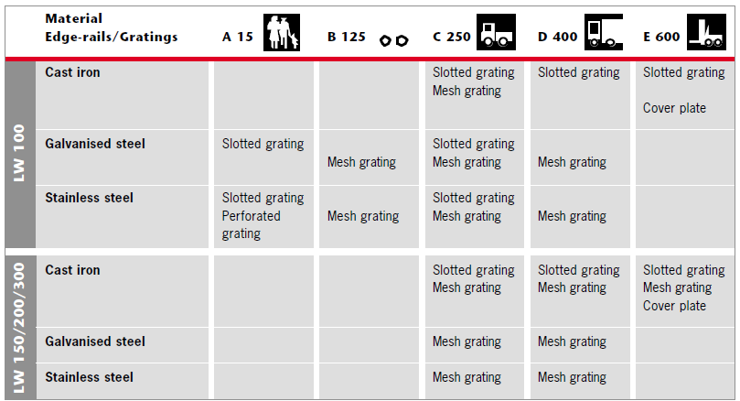
Multiline
Gratings and Brickslot

Slide 16
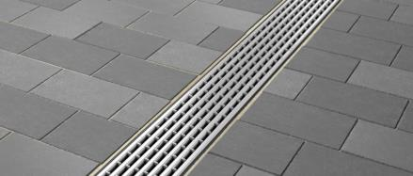
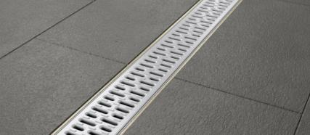
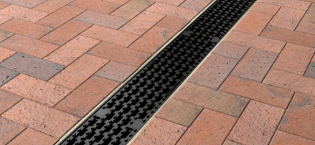
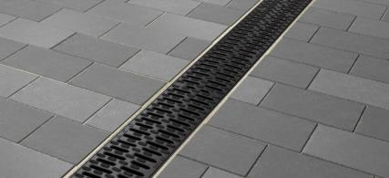
Multiline
Gratings and Brickslot
Stainless Steel
Galvanised Steel
Cast Iron
Polypropylene

Slide 17
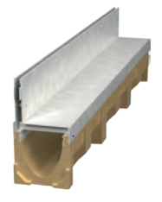
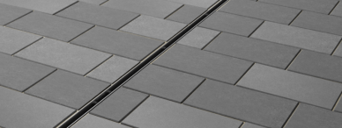
Multiline
Gratings and Brickslot
ACO Brickslot is a subtle and unobtrusive grating which can be used to complement discreet drainage applications when combined with an
ACO DRAIN channel. Compatible with most paving materials, the vertical sides of the grating enable pavements to be laid directly against the unit´s edge.
System Advantages
Enforced top of the slot
Easy maintenance and access
Easy installation
May be installed with any paving material
Range of gratings for discreet line drainage
Totally secured system
Fast removal of surface water
Fully EN 1433 tested and certified

Slide 18
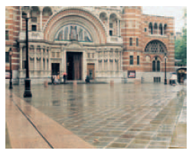
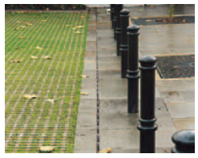
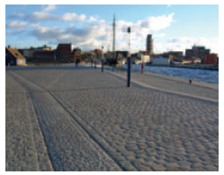
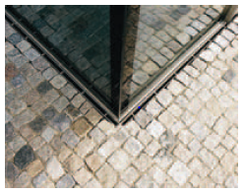
Multiline
Gratings and Brickslot
Brickslot - Fields of Application
Ideal for use against buildings facades, for level threshold drainage and pedestrian areas thanks to narrow heel-safe slot geometry.

Slide 19
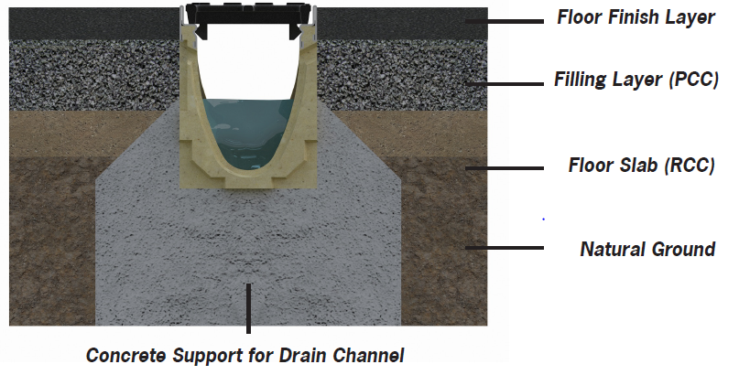
Multiline
Installation
ACO Multiline drain systems consist of a full range of channels, gratings and sump units. When installed correctly, the system is designed to withstand a variety of loadings classified by EN 1433.

Slide 20
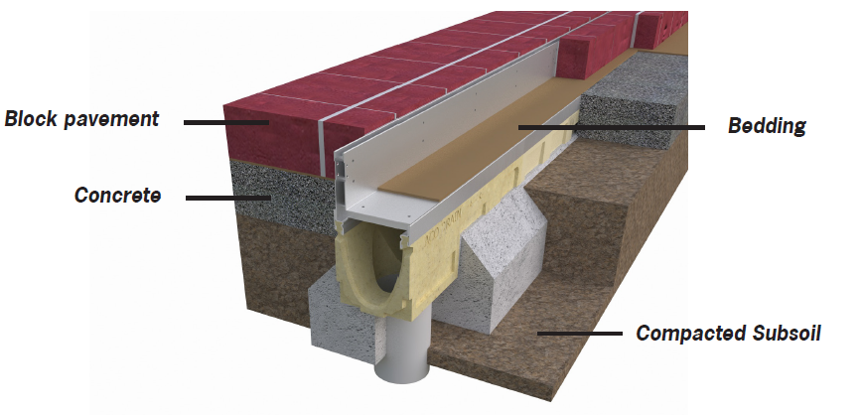
Multiline
Installation
Typical equipment to be used for the installation are excavation equipment, string line and laser level, measuring tools, drill, grinder, saw, rubber hammer and the appropriate back-fill material.

Slide 21
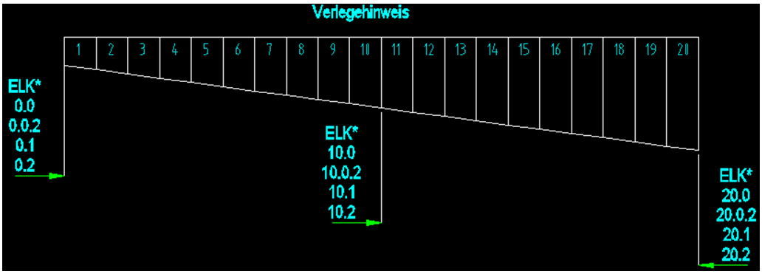
Multiline
Sizes and Dimensions
Details of 20 m sloped channels

Slide 22
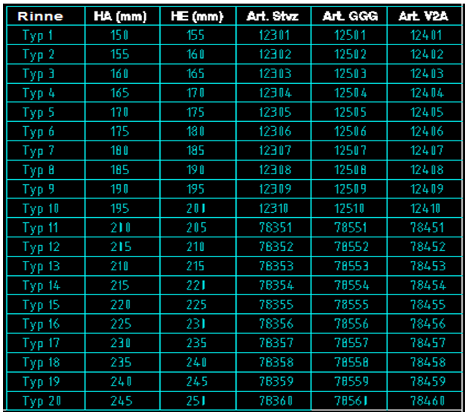
Multiline
Sizes and Dimensions
V100 Multiline: Start- and end depth

Slide 23
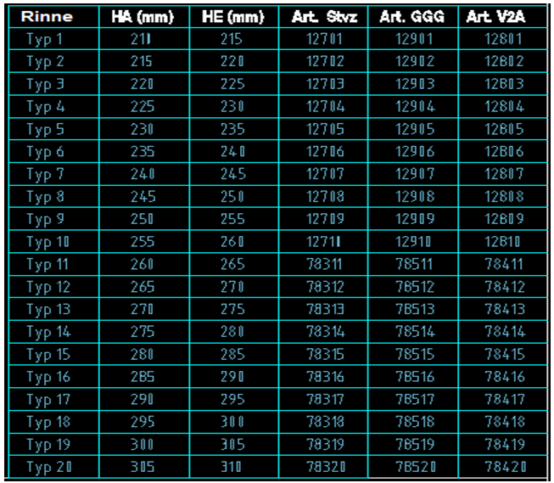
Multiline
Sizes and Dimensions
V150 Multiline: Start- and end depth

Slide 24
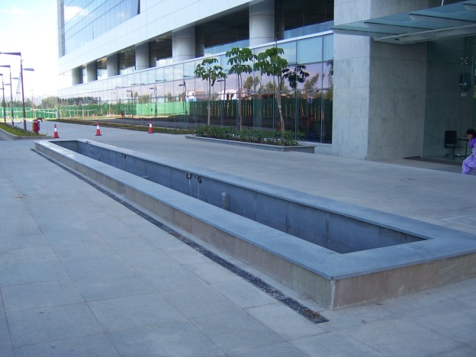
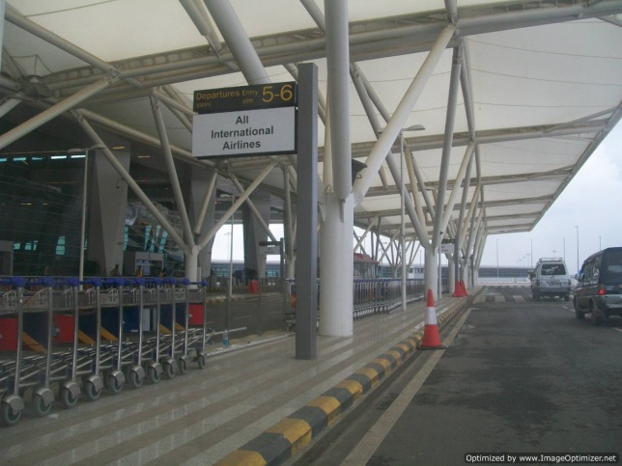
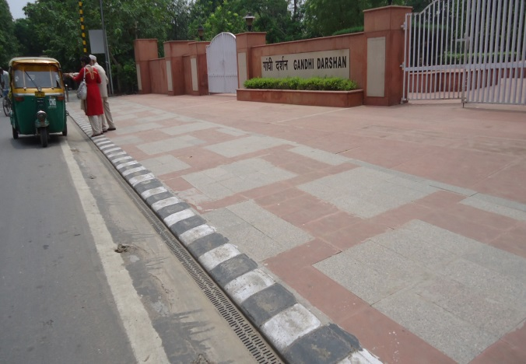
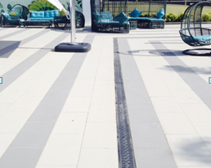
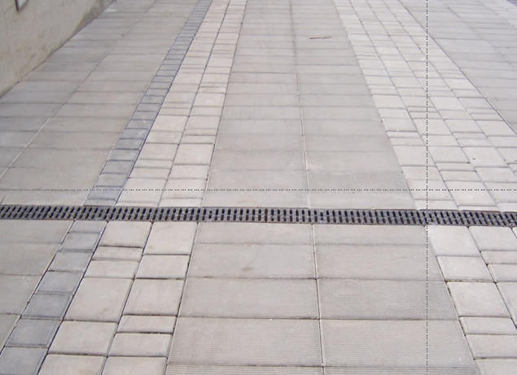
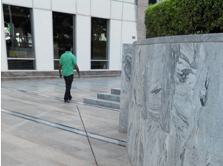
Multiline
Selected References
Vrindavan Tech Park Bangalore.
Indira Gandhi International Airport, New Delhi
Rajghat, New Delhi
Adani Shantigram Belvedere Club, Gujarat
PR Builders, Mumbai
DLF Cyber Hub, Gurgaon

