Slide 1
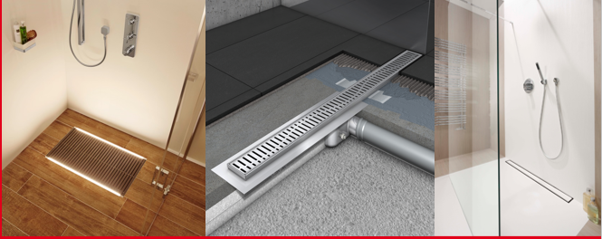
ACO ShowerDrain
Modern and Efficient Drainage
for Shower Areas
Stadtlengsfeld, 22th September 2016

Slide 2
Overview
History and Customer Needs
Product Standards and Installation Requirements
ACO ShowerDrain Product Portfolio
Innovations for Tomorrow

Slide 3
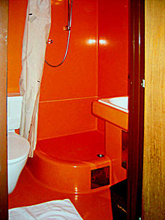
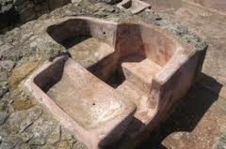
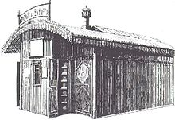
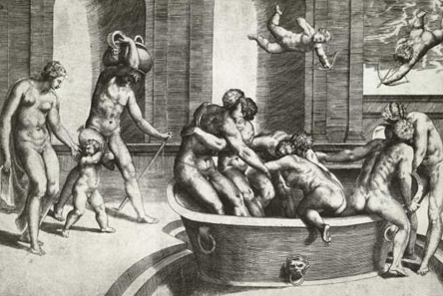
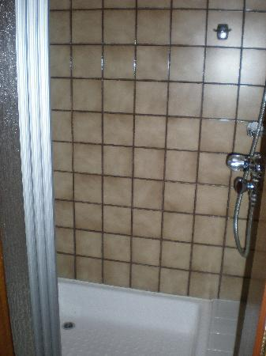
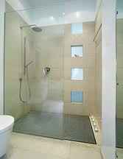
Evolution – History of Bathrooms
13. Jh.
1966
2006
2000 v. Chr.
1850
1985

Slide 4



ACO ShowerDrain – Today‘s Market Presence – Competitors

Slide 5

ACO ShowerDrain - Today‘s Market Presence
ACO ShowerDrain - today
Market presence

Slide 6
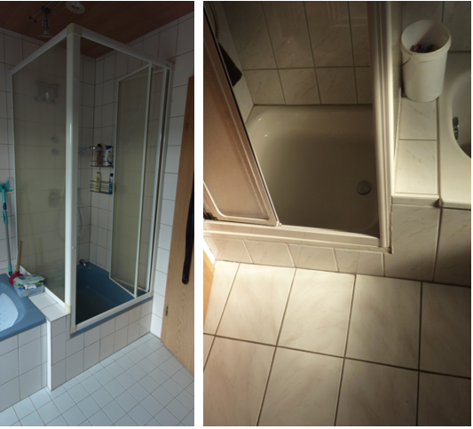

Areas of Application Daily Use
Actual Situation: Renovation holdup
Outdated Shower places with High Entry Barrier

Slide 7
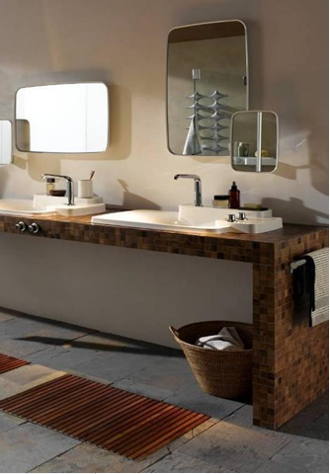

Areas of Application Universal Design
Flexibility for Use
Simple and Intuitive Operation
Minimized Physical Effort
Result = Usability for all + Design

Slide 8
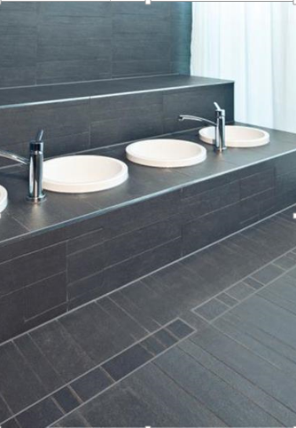
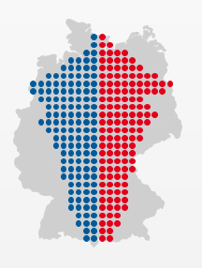
Areas of Application Demographic Shift
Senior homes, Senior residences
Hospitals, Rehab facilities
SPA, Wellness resorts, Gyms, Sport facilities
Hotels, Recreational areas, Service areas
Private residential buildings

Slide 9
Overview
History and Customer needs
Product Standard and Installation Requirements
ACO ShowerDrain Product Portfolio
Innovations for Tomorrow

Slide 10

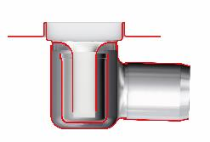
Product norm EN 1253
Product scope
Old
  Norm for floor and roof gullies. Shower channels were not included
  Part 1 = Requirements with and without foul air trap (FAT)
  Part 2 = Testing procedures with and without foul air trap (FAT)
New
  Floor gullies with foul air trap include shower channels
  Part 1 = Gullies with 50 mm foul air trap (FAT)
  Part 2 = Gullies without foul air trap (FAT) (e.g. roof gullies)

Slide 11

Product norm EN 1253
Temperature cycle test
Old
  A test procedure to check the performance of the product under different water temperatures
New
  Differentiation of testing accoding to scope of application
    class A: 1500 cycles
    → all applications
    class B: 360 cycles
    → Private bath rooms
    (DN 32 to DN 75)

Slide 12
Product norm EN 1253
Temperature cycle test
New
Temperature cycle test for products acc. to
class A with 1500 cycles
class B with 360 cycles
  One cycle includes:
1
  60 s: 93°C hot water 0,5 l/s
2
  60 s: Pause
3
  60 s: 15°C cold water 0,5 l/s
4
  60 s: Pause

Slide 13
Product norm EN 1253
Slope for outlet spigot
Old
  Pipe running from the outlet spigot shall be isntalled with 2% slope against horizontal line
New
  Pipe running from the outlet spigot shall be isntalled with 1,5% slope against horizontal line

Slide 14



Product norm EN 1253
Flanges
Old
  No definition for flanges in combination with fluid sealing systems (e.g. thin bed sealing)
New
  Effective minimal flange width 30mm for adhesive flange to apply fluid sealing systems or glued sealing membranes

Slide 15

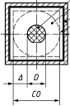
Product norm EN 1253
Loading test
Old
  Standardized test blocks for gullies and channels
  4 clear openings: <140, 140–200, 200–300, >300
  No unsupported distance between test block and edge of grating defined
300
New
  Round test blocks for gullies, rectangular test blocks for channels
  6 clear openings: 25–50, 50–90, 90–140, 140–200, 200–300, >300
  Unsupported distance between test block and edge of grating defined

Slide 16

Product norm EN 1253
Apertures in gratings (holes, slots)
Old
  Acceptable apertures for bare feet area between 6 and 8mm
  No definition for apertures inside slot channels
New
  Acceptable apertures for bare feet area between 4 and 8mm
  Apertures may also be between grating and frame (slot drainage)

Slide 17
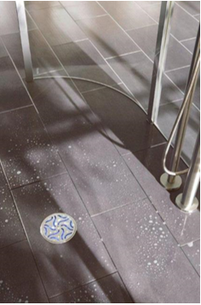
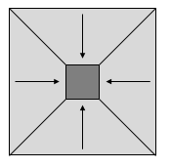
Installation Requirements
Slope and Flow rates
  Slope in 4 directions needed for floor gullies

Slide 18
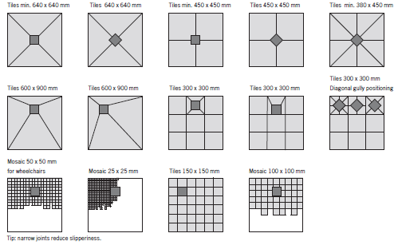
Installation Requirements
Slope and Flow rates
  Design examples for Floor gullies

Slide 19
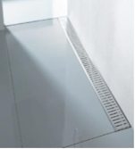
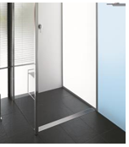
Installation Requirements
Slope and Flow rates
  Slope in one direction for shower channels
at the wall
inside the room

Slide 20
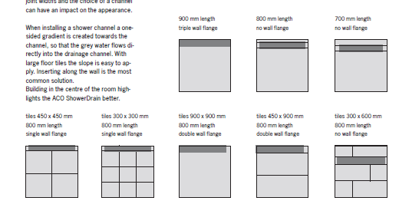
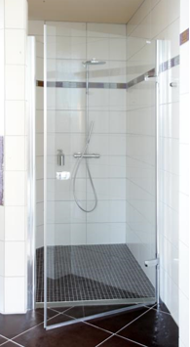
Installation Requirements
Slope and Flow rates
  Design examples for shower channels

Slide 21
Installation Requirements
Slope and Flow rates
  For location at the wall water stacking is technically possible
  0.4 l/s
  (no water stacking)
  0.6 l/s (water head
  acc. to EN 1253-1,
  20 mm),
    (must be min. 0.4 l/s)
Slope approx. 1.5 %
Slope approx. 1.5 %

Slide 22
Installation Requirements
Slope and Flow rates
  For location inside the room water stacking is technically not possible
  0.4 l/s
  (no water stacking)
  Water head acc. to EN 1253-1
  not possible
Slope approx. 1.5 %
Slope approx. 1.5 %

Slide 23

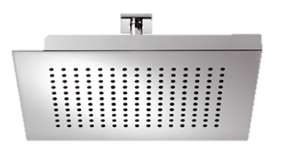

Installation Requirements
Slope and Flow rates
  Flow rates of shower installations
Hand shower
Head shower
Head shower Rain Sky
  approx. 18 l/min.
  at 3 bar
  0.30 l/sec.
  approx. 22 l/min.
  at 3 bar
  0.37 l/sec.
  > 0.4 l/ sec.

Slide 24
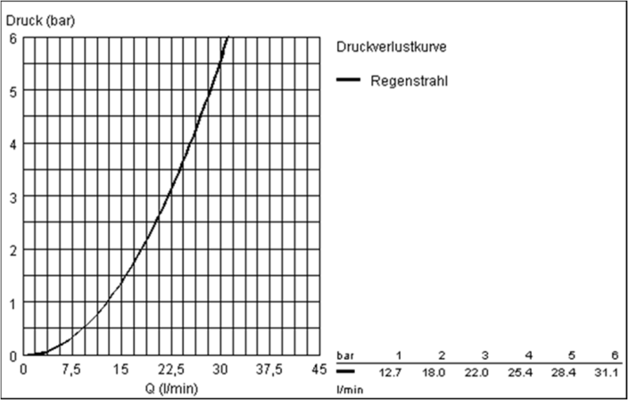
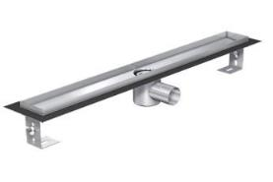
Installation Requirements
Slope and Flow rates
  Interface between shower head and shower channel
24 l/min = 0.4 l/ s
Water stacking a. grating
Number of gullies
0 mm
5 mm
15 mm
1 gully
0.4 l/s
0.5 l/s
0.6 l/s
2 gullies
0.7 l/s
0.8 l/s
1.0 l/s
3 gullies
1.0 l/s
1.25 l/s
1.4 l/s

Slide 25
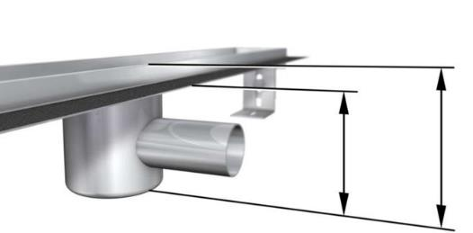
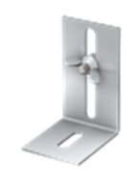
Installation Requirements
Design and Dimensions
  Installation height: standard FAT acc. to EN1253
  (e.g.: ACO ShowerDrain E)
Building height 90 mm (1)
Installation height 105 mm (2)
Adjustability + 55 mm (3)
Foul air trap 50mm acc. to EN 1253 part 1
(1)
(2)
(3)

Slide 26
Installation Requirements
Design and Dimensions
  Installation height: renovation solution
  (e.g.: ACO ShowerDrain E)
Building height 64 mm (1)
Installation height 79 mm (2)
Adjustability + 55 mm (3)
Foul air trap 25 mm
(1)
(2)
(3)

Slide 27
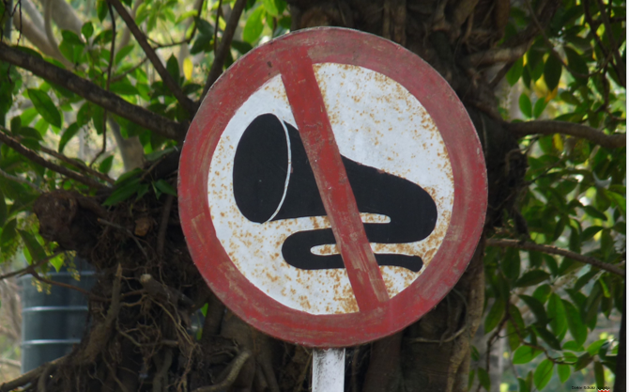
Installation Requirements
Noise Protection

Slide 28
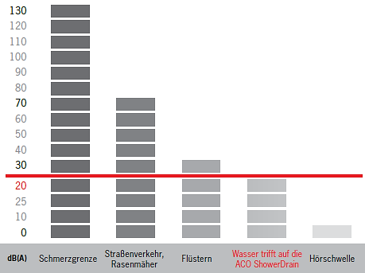


Installation Requirements
Noise Protection
  Celestial peace: German noise guidelines
DIN 4109, A1 – noise protection in buildings
≤ 30 dB
VDl 4100, SSt – noise protection in residential buildings, (higher requirements)
≤ 22 dB
Highest noise requirements are standard for
ACO ShowerDrain

Slide 29
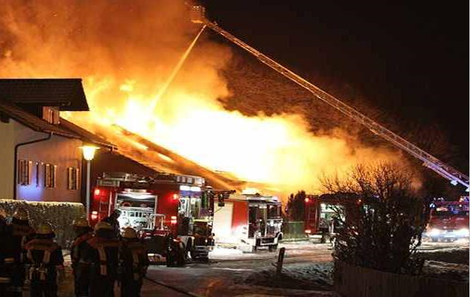
Installation Requirements
Fire Protection

Slide 30
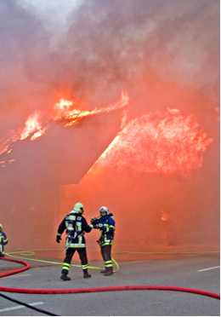
Installation Requirements
Fire Protection
Fire is an extremelly dangerous incident according to civil and public law.
National laws require to take prevent actions in order to avoid catastrophies.
National laws maybe detailed on regional level by specific:
Fire and rescue regulations
Building regulations related to fire protection

Slide 31
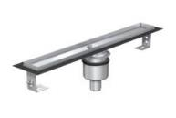
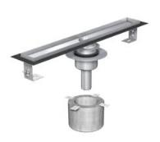
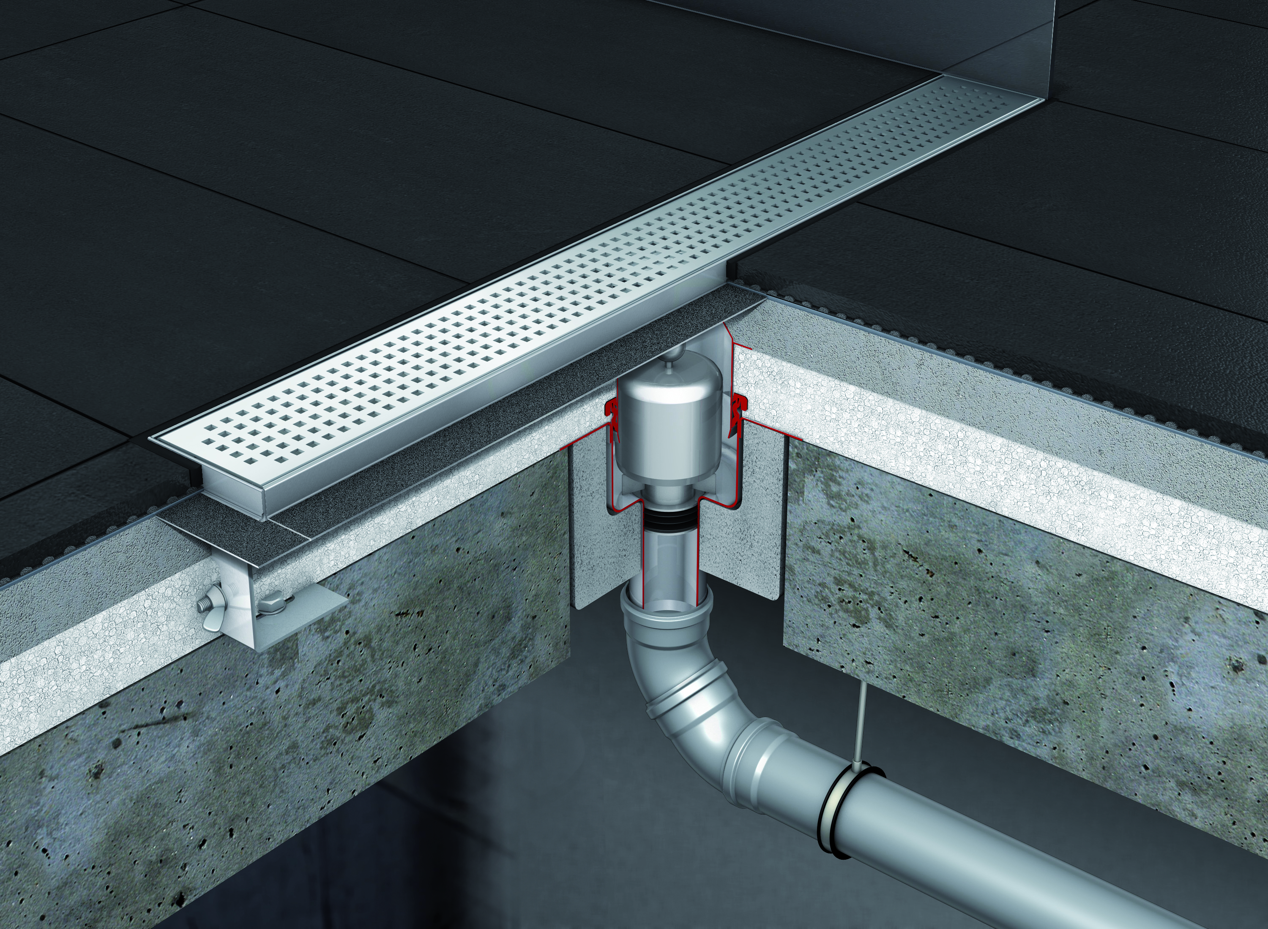
Installation Requirements
Fire Protection
  The Product Solution
After 120 min. ≤ 180 °C
No smoke or fire passage
Acc. to German fire class R 120
All grating designs maybe used
Target
Enable rescue
Provide escape route
Gain time

Slide 32
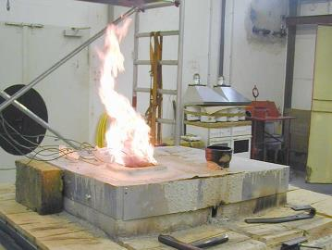
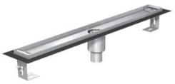
Installation Requirements
Fire Protection
  … in order to avoid this incident.
Smoke and fire passage to upper floor, when using vertical shower channels or gullies without fire protective solution
Vertical shower channel without fire protective solution

Slide 33
Overview
History and Customer needs
Product Standards and Installation Requirements
ACO ShowerDrain Product Portfolio
Innovations for Tomorrow

Slide 34
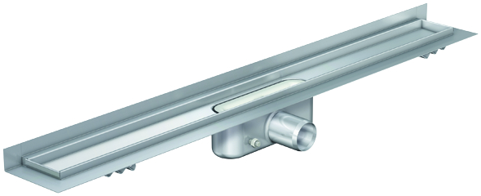
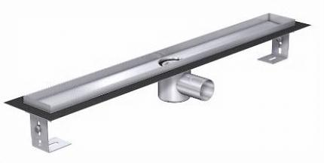
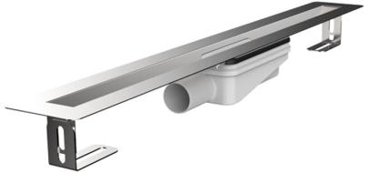
ACO ShowerDrain
Plattform & Product portfolio*
Good
Better
Best
ACO ShowerDrain B
The basic channel
ACO ShowerDrain C
The functional channel
ACO ShowerDrain E
The versatile channel
ACO ShowerDrain S
The elegant channel
*In addition: customized+special shower channels (i.e. ShowerDrain X)

Slide 35
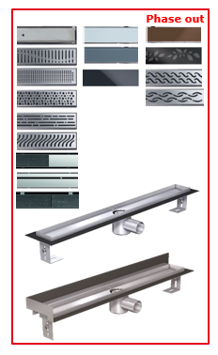
ACO ShowerDrain product portfolio
ACO ShowerDrain E
Flow rates
  No water stacking: 0.4 l/s
  With stacking (20 mm): 0.6 l/s
Building - installation height
  64-79 mm ND40 WS25
  90-105 mm ND50 WS50
Floor sealing
  Fully welded gully body
  Fully integrated 30mm steel flange
Handling
  Feet pre-installed
  One-piece product solution
Length
  700/ 800/ 900/ 1000/ 1200 mm

Slide 36
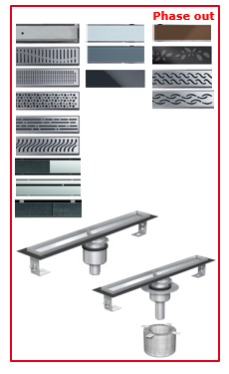
ACO ShowerDrain product portfolio
ACO ShowerDrain E – fire protection
Flow rates
  No water stacking: 0.5 l/s
  With stacking (20 mm): 0.65 l/s
Building - installation height
  64-79 mm ND40 WS25 (Fit-in)
  90-105 mm ND50 WS50 (no Fit-in)
Floor sealing
  Fully welded gully body
  Fully integrated 30mm steel flange
Handling
  Easy vertical installation by core bore and Fit-in
  One-piece product solution
Length
  700/ 800/ 900/ 1000/ 1200 mm

Slide 37





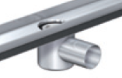


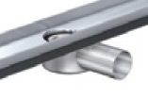

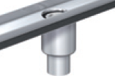
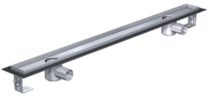
ACO ShowerDrain product portfolio
ACO ShowerDrain E – variety & individuality
Grating
Length
Flange
Gully
Safety
Accessor.
Max. 3 (flow rate up to 1.4 l/s),
Individual position
max. 2400 mm
  In Addition:
  Customized frame height for natural stone/ marble (16-30 mm)
  Individual Logos

Slide 38
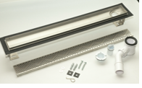
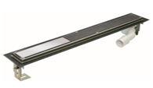
ACO ShowerDrain Produkt Portfolio
RUG Self Comfort
Flow rate
  No water stacking: 0.35 l/s
  With stacking (20 mm): 0.55 l/s
Building - installation height
  Shark: 123 (108) mm ND 40/50
  Twist: 101 (86) mm ND 40/50
Shark Comfort
Floor sealing
  Rotateable gully (360°)
  Fully integrated 30mm steel flange
Handling
  Feet pre-installed, height-adjustable
Length
  800/ 900/ 1000 mm
Twist Comfort

Slide 39
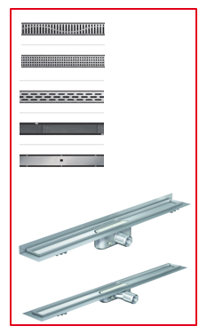
ACO ShowerDrain Product Portfolio
ACO ShowerDrain C
Flow rates
  No water stacking: 0.5 l/s
  With stacking (20 mm): 0.9 l/s
Building - installation height
  53-65 mm ND40 WS30
  80-92 mm ND50 WS50
Floor sealing
  Fully welded gully body
  Fully integrated 30mm steel flange
Handling
  Concrete anchors / flaps
  One-piece product solution
Length
  558/ 685/ 785/ 885/ 985/ 1185 mm

Slide 40
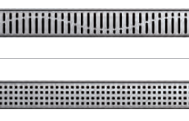
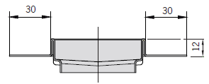
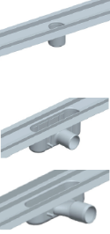
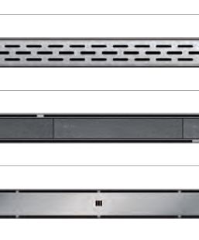


ACO ShowerDrain Product Portfolio
ACO ShowerDrain C customized
Grating
Length
Flange
Gully
min. 400 mm
max. 2200 mm
Max. 3 pieces
  In Addition:
  Surface treatment
  Coated flange
  Anchor or height-adjustable feet

Slide 41


ACO ShowerDrain Product Portfolio
ACO ShowerDrain B
Flow rates
  No water stacking: 0.35 l/s
  With stacking (20 mm): 0.55 l/s
Building - installation height
  87 mm ND 40/50 WS 25 mm
ACO ShowerDrain B
Floor sealing
  Rotateable gully
  Fully integrated 30mm steel flange
Handling
  Concrete anchors / flaps
Length
  685/ 785/ 885/ 985 mm
RUG Self Shark Standard

Slide 42


ACO ShowerDrain Product Portfolio
ACO ShowerDrain S
Plate
Flow rates
  No water stacking: 0.35-0.50 l/s
  With stack.(20 mm): 0.55-0.80 l/s
Stripes
Building height
  55 mm ND32/40 WS25
  64 mm ND40 WS34
  80 mm ND50 WS50
Floor sealing
  Fully welded gully body
  Fully integrated 30mm steel flange
Handling
  Feet pre-installed
  One-piece product solution
Length
  700/ 800/ 900/ 1000/ 1200/
  1500 mm
  From 1000 mm: 2 gullies

Slide 43


ACO ShowerDrain Product Portfolio
ACO ShowerDrain S
Scope of delivery:
1 grating
4 different feet
  H= 11, 14, 16 or 22 mm
On site adjustment to the height of tiles

Slide 44

ACO ShowerDrain Product Portfolio
ACO ShowerDrain S

Slide 45


ACO ShowerDrain
Product Portfolio Strategy
Good
Better
Best
Sanitary
wholesale
B
C
E / S
Builder’s Merchants
B
C
E / S
DIY
?
RUG Self Standard
RUG Self Comfort
http://www.rug-self.com/files/RUG_Self_Ablaeufe_2015_rus.pdf

Slide 46
ACO ShowerDrain
Product Differentiation
Shower Channel
Gully
Flange
Grating
Fixation
Length
Surface
Options
Material steel
Welded
Access to
piping
FAT 2 heights
Width
30 mm
Steel
Coated
Wall version
Steel (>5)
Tile grating
Glass grating
Adjustable feet
Standard + Customizing
Electro pol.
Light
Multiple gullies
Noise-Stop
Fire-Stop
Smell-Stop
Best
Material steel
or plastic
Pre assembled (water tight)
Access to piping
Width
30 mm
Steel
Wall version
Steel 5 designs
Tile grating
Steel anchors (flaps)
Fixed sizes 700 –
1200 mm
Grinded
Pickle passivated
Noise-Stop
Better
Material plastic
rotatable
Width
30 mm
Steel/Plastic
Steel/
Plastic
No fixation
Fixed sizes 700 –
900 mm
Plastic, not coated
No options
Good

Slide 47


ACO ShowerDrain Product Portfolio
ACO ShowerStep/ RUG Self Profilschiene
Surface treatment
  Electro-polished
  Grinded
Version
  Left
  Right
Tile thickness
  10 mm
  12,5 mm
  15 mm
Length
  990 mm
  1490 mm
  Individual cutting on site
  Glass wall can be installed on ShowerStep
  RUG Self: only 15 mm, gebürstet available
Notes:
12 mm width → installation Glaswall

Slide 48
Overview
History and Customer needs
Product Standards and Installation Requirements
ACO ShowerDrain Product Portfolio
Innovations for Tomorrow

Slide 49
ACO ShowerDrain Strategic Meeting
Agenda
ShowerDrain X

Slide 50

ACO ShowerDrain X

Slide 51

ACO ShowerDrain X
Less warm drinkable water is needed to heat up the showering water
38 % Efficiency

Slide 52

ACO ShowerDrain X
60-70°C
60-70°C
10°C
20°C
10°C

Slide 53

ACO ShowerDrain X
https://www.youtube.com/watch?v=saPTsi-OZac

Slide 54
ACO ShowerDrain Strategic Meeting
Agenda
ShowerDrain
Walk-in

Slide 55

ACO Walk-in
Therm Grating Coal

Slide 56

ACO Walk-in
Therm Grating Timber

Slide 57

Therm Gratings
Material
WPC – Wood Plastic Composite
→ Thermoplastic processed material
65% wood fibre
35% polymer
UV resistant
Chlorine water resistant
Salt water resistant
Splinter proof
Wooden feel of surface

Slide 58



ACO Walk-in
System Overview
1
Application
700 x 500 mm
800 x 500 mm
900 x 500 mm
1000 x 500 mm
1200 x 500 mm
2
Size
3
Design
4
Gully

Slide 59


Slide 60
ACO ShowerDrain Strategic Meeting
Agenda
ShowerDrain
Lightline Pro

Slide 61

ACO Lightline Pro

Slide 62

ACO Lightline Pro

Slide 63

ACO Lightline Pro

Slide 64

ACO Lightline Pro
Product Information
Pre-manufactured stainless steel channel with integrated LED lights
Stainless steel 1.4301, e-polished
Installation height 10 mm (for integration into tiled floor)
Width 15 mm
Available lengths 700 to 1200 mm
Light options
  Neutral white (4.000 K)
  Cold white (6.000 K)

Slide 65
ACO Lightline Pro
Details
Suitable for barefeet- and wet areas (Area 0 acc. to DIN VDE 0100-701)
Protective class IP 68 (DIN 40050)
Connected cable 5 m
For combination with mains adapter 24V, DC (scope of delivery)
Life time until 80% luminance: >40.000 h
  Equals 55 years based on 2h operations per day

Slide 66

Free integration into the floor
Installation independent of a channel
Handling via a light switch

Slide 67
ACO ShowerDrain Strategic Meeting
Agenda
ACO ShowerDrain W

Slide 68

ACO ShowerDrain W – Netherlands
Drainage into the Wall

Slide 69
ACO ShowerDrain Strategic Meeting
Agenda
ACO ShowerDrain
Sales support

Slide 70

ACO ShowerDrain
Sales Support
ACO ShowerDrain sales stand
ACO ShowerDrain display
ACO ShowerDrain sample case

Slide 71

International Sales Support
Installation Video
https://www.youtube.com/watch?v=uKl-EE23N2k

Slide 72

ACO ShowerDrain
Sales Support
Online Design Configurator
http://app.aco-haustechnik.de/badkonfig/konfigurator_en.html

Slide 73


