Slide 1
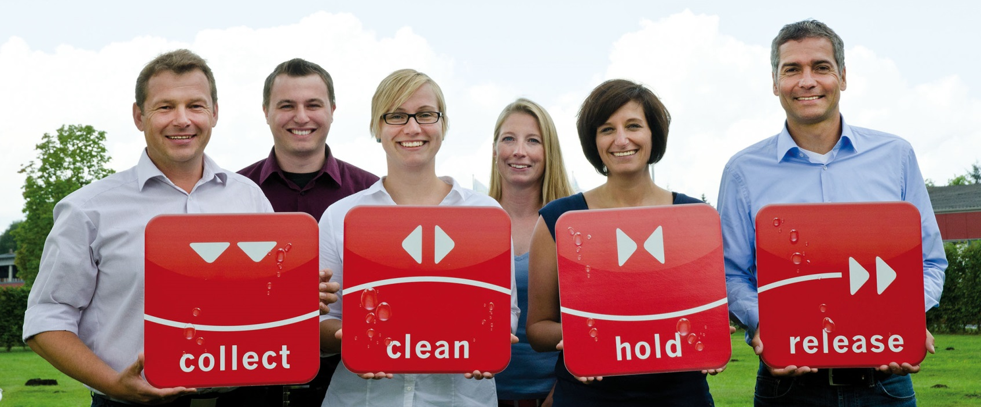
ACO. The future of drainage.
ACO Systems and Solutions
Author
Event, Location, Date

Slide 2
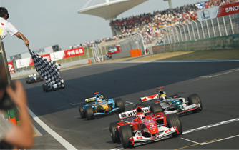
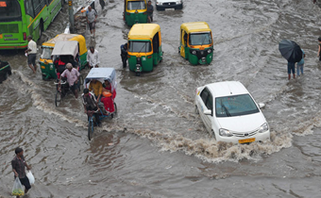
ACO The future of drainage
Our Vision:
ACO is the world leader in drainage technology
We see our markets through the eyes of our customers.
We like to keep in close contact with them to impress them with the best products and services.
Our Mission:
ACO creates solutions for tomorrow‘s
environmental conditions
Global climate change is causing more frequent
extreme weather events such as droughts and
heavy rainfall. We develop innovative system solutions
to weather these events.

Slide 3
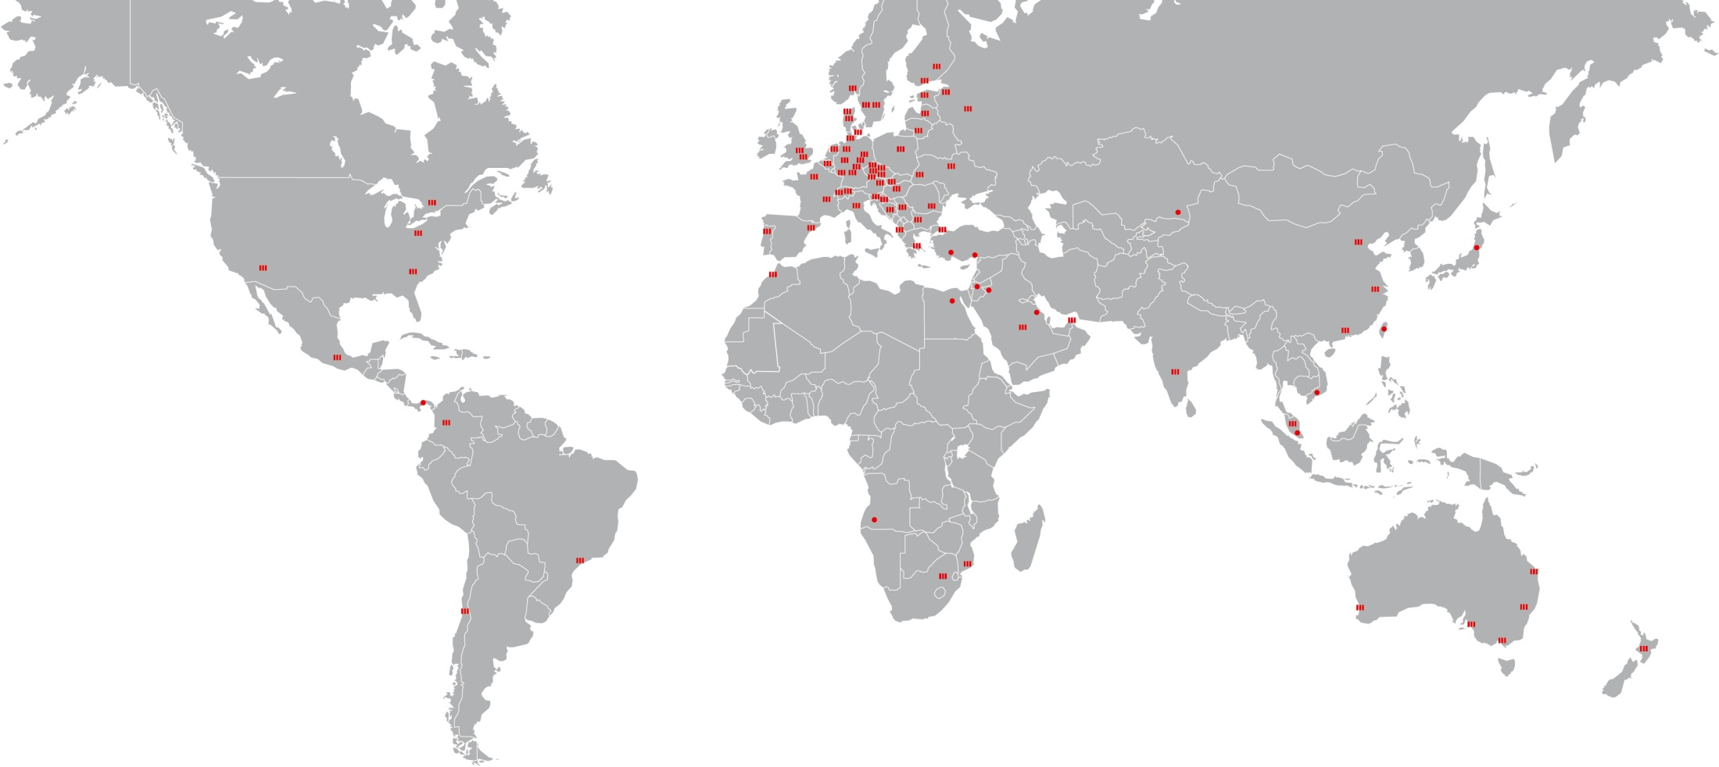
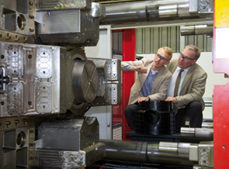
The ACO Group A Strong Brand Around the World
Founded in 1946
Headquarter in Rendsburg, Germany
4,200 employees in more than 40 countries
30 production sites in 15 countries
Sales 2015: 705 Mio. Euro

Slide 4
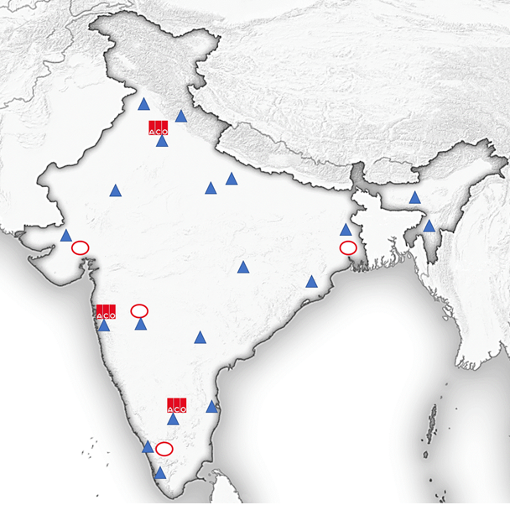
The ACO Group – A Strong Brand in India ACO Sales Network
Sales organisation covering the entire Indian market
Team of application engineers to support the sales
Marketing, customer service and finance
Main office in Bangalore
Regional sales offices in
Mumbai and New Delhi
Extensive channel partner network
ACO Office
ACO Sales Employee
ACO Channel Partner

Slide 5
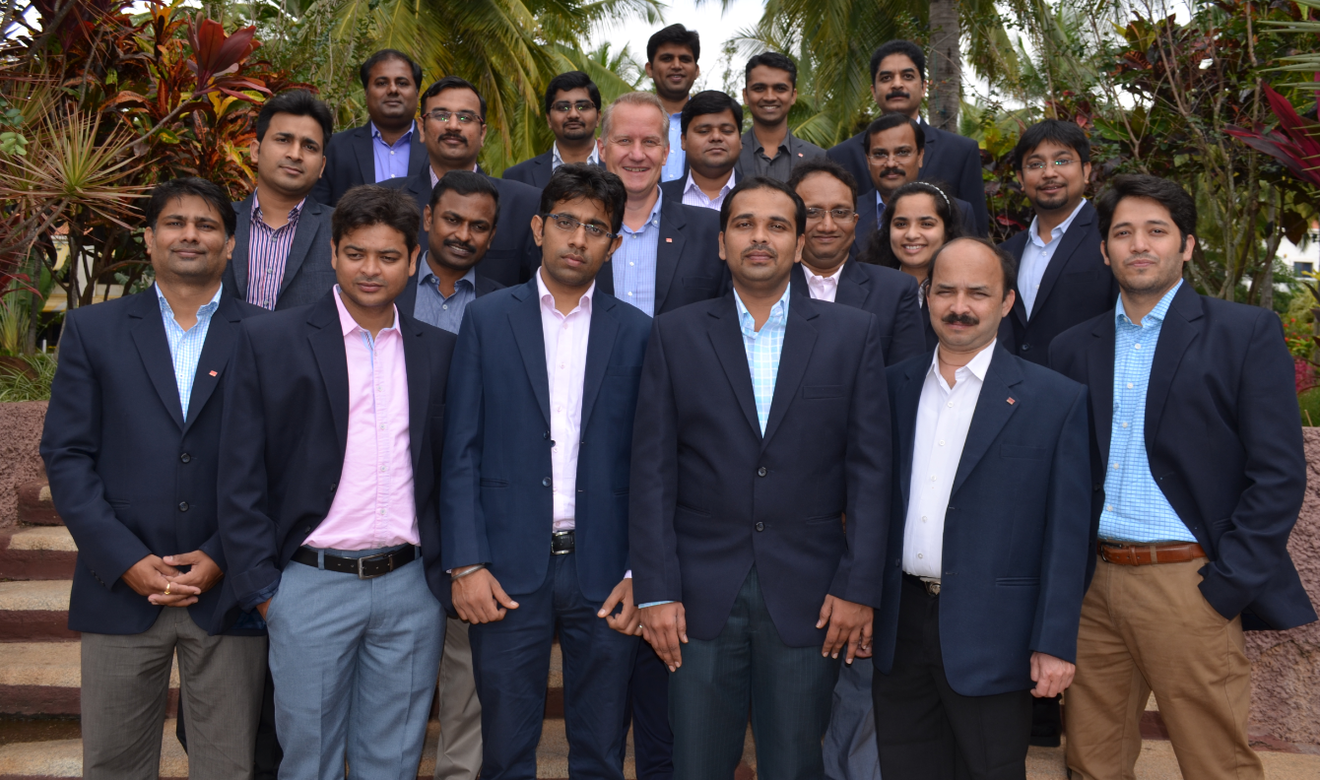
The ACO Group – A Strong Brand in India ACO Sales Team

Slide 6
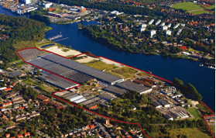
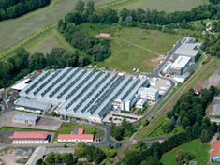
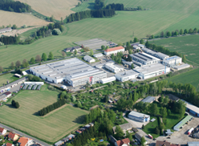
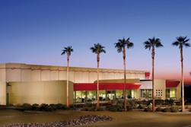
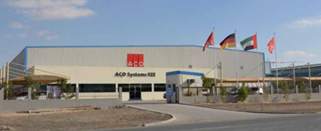
The ACO Group – A Strong Brand in India Factories delivering to the Indian market
Rendsburg, Germany
Stadtlengsfeld, Germany
Pribyslav, Czech Republic
Casa Grande, USA
Dubai, UAE

Slide 7
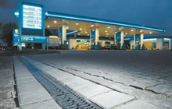
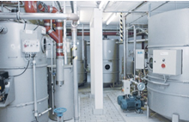
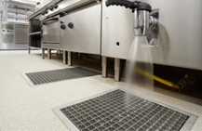
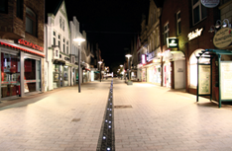
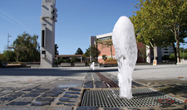
ACO Your Partner in Water Management Solutions
Infrastructure
– Safeguarding future mobility
Ecology
– Clean solutions for our environment
Hygiene
– Ultimate hygienic drainage performance
Landscaping
– Esthetic and efficient drainage solutions

Slide 8
ACO System Chain Your Partner in Water Management Solutions
Collect:
Gather and capture
Clean:
Pre-treat and process
Hold:
Retain and contain
Release: pumping, discharging
and reusing

Slide 9
ACO Service Chain Your Partner in Water Management Solutions
Train:
Information and further education
Design:
Planning, consulting and optimisation
Support: Construction advice and assistance
Care:
Inspection and servicing

Slide 10
ACO Awards Perfection is also a Pleasure

Slide 11
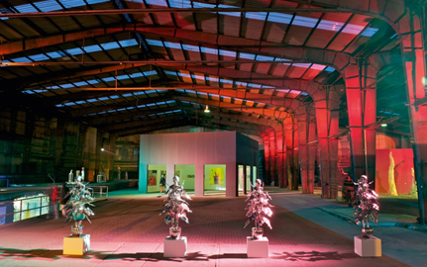
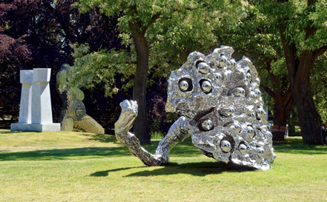
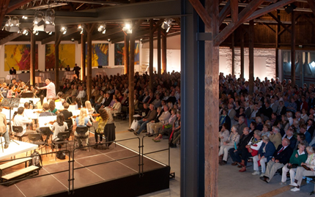
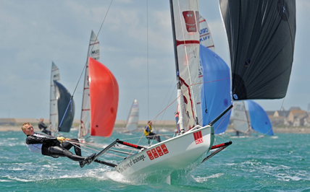
ACO…… is much more than Water Management Solutions
Kunstwerk Karlshuette
ACO Sculpture Park
Schleswig Holstein Music Festival
Musto Skiff World Championships

