Slide 1
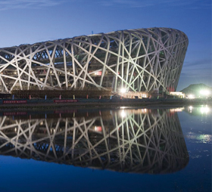
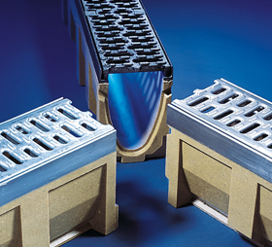
Xxxxx

Slide 2
Notes:
Basically the turnover has not improved since 2009 (Apart from 2 significant projects F1 and Commonwealth Games)

