Slide 1
ACO Haustechnik Grease separators, competition: KESSEL
November 2016

Slide 2
Contents
Company information
Product Portfolio Grease Separators
Evaluation

Slide 3
1. Company information

Slide 4
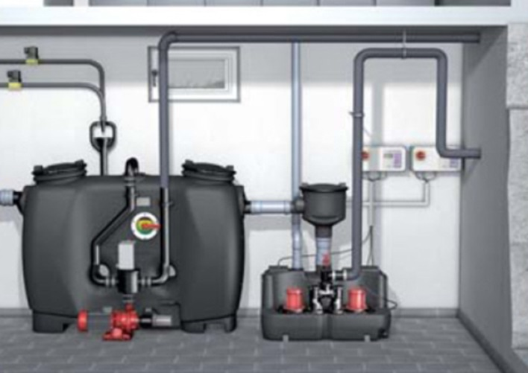
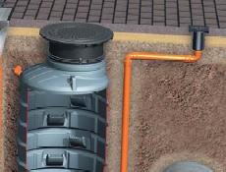
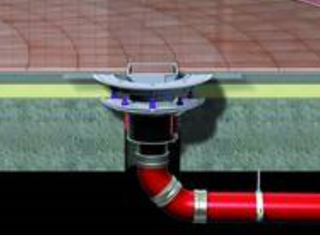
Company information
Product Portfolio:
Backflow preventers
Lift plants
Drainage systems
Grease separators
Light oil separators
Small sewage works

Slide 5
Company information
Foundation: 1963 (tooling)
Headquarters: Germany
Employees: 500 (2016)
Total turnover: 80 Mio € (2016)
Total turnover grease separators: 10 - 12 Mio € (2016)

Slide 6
Company information
Markets active:
Worldwide activities

Slide 7
2. Product Portfolio Grease Separators

Slide 8
Full disposal (above ground)

Slide 9
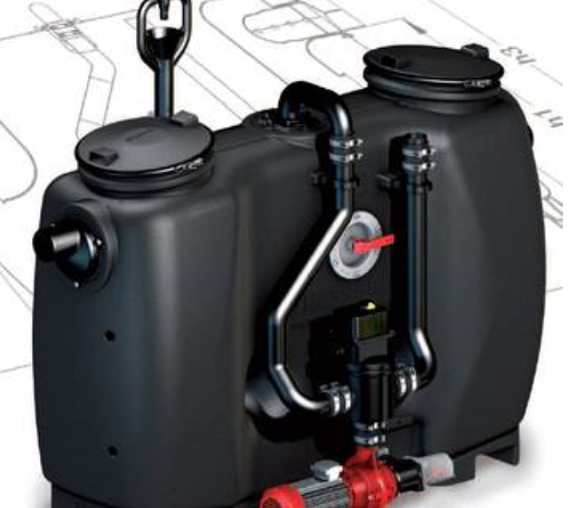
Product Portfolio Grease Separators
Grease separators for full disposal: EasyClean

Slide 10
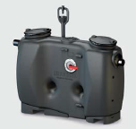
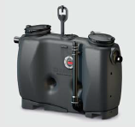
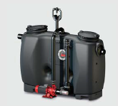
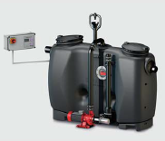
Product Portfolio Grease Separators
EasyClean – product range
Basic model
Extension stage 1 (direct suction)
Extension stage 2 (shredder-mix)
Extension stage 3 (automated shredder-mix)

Slide 11
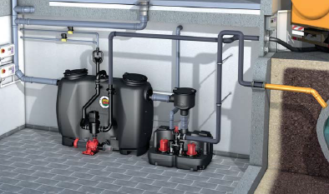
Product Portfolio Grease Separators
EasyClean Series – product portfolio
https://www.youtube.com/watch?v=AQvS3elxDWg

Slide 12
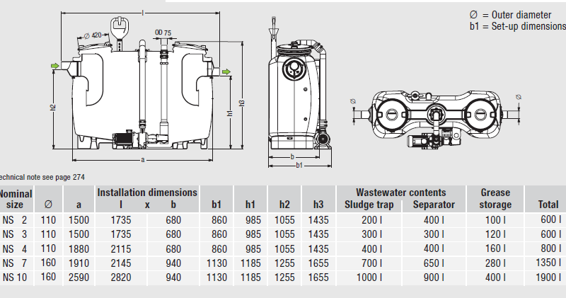
Product Portfolio Grease Separators
EasyClean – product range
Nominal Sizes: 2, 3, 4, 7, 10

Slide 13
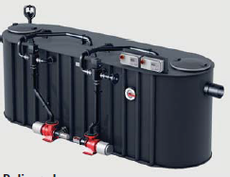
Product Portfolio Grease Separators
Euro Auto Mix & Pump (PV+S)
Nominal Sizes: 15, 20, 25 (higher Nominal Sizes on request)

Slide 14
Full disposal (below ground)

Slide 15
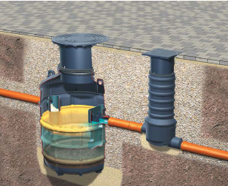
Product Portfolio Grease Separators
Grease separators for full disposal: Euro „G“
NS 1, 2 and 4

Slide 16
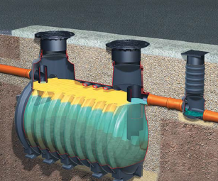
Product Portfolio Grease Separators
Grease separators for full disposal: Euro „G“
NS 7
NS 10 NS 15 NS 20 NS 25 NS 30
NS 35

Slide 17
Product Portfolio Grease Separators
Grease separators for full disposal: Euro „G“
No extension stages available (not even direct suction)
Load class A, B or D
Ground water protection inferior to ACO solution

Slide 18
Partial disposal

Slide 19
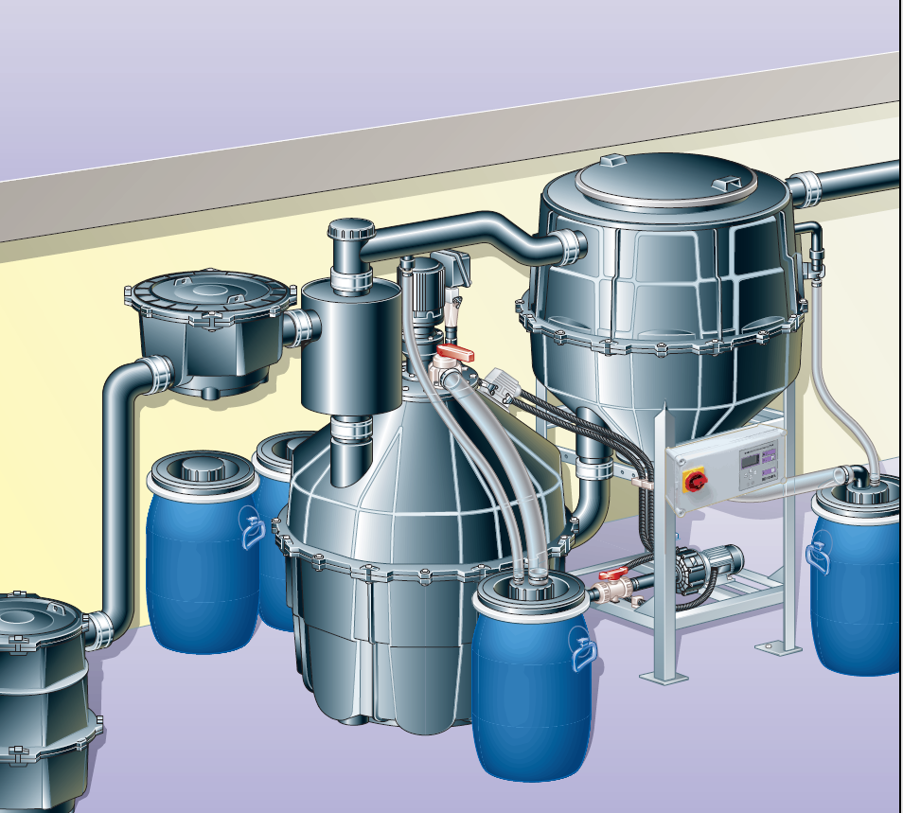
Product Portfolio Grease Separators
Grease separators for partial disposal: KESSEL SE
NS 2, 4, 7, 10

Slide 20
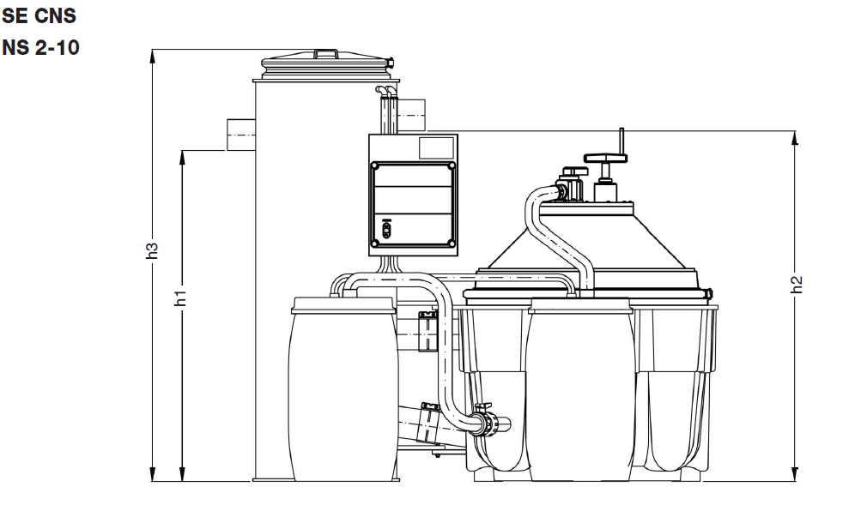
Product Portfolio Grease Separators
Grease separators for partial disposal: KESSEL SE CNS
NS 2, 4, 7, 10

Slide 21
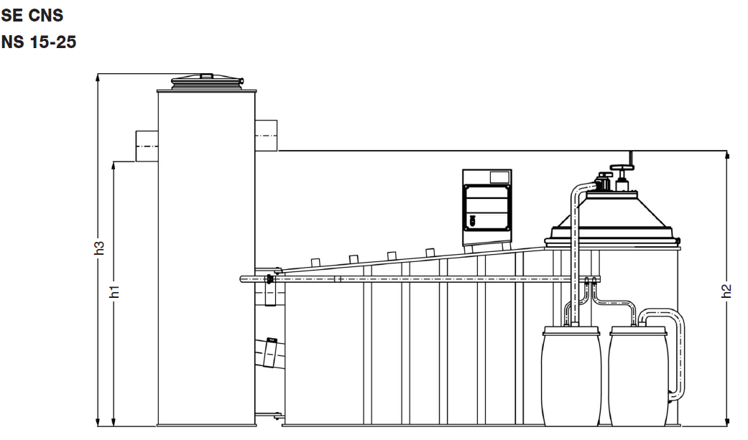
Product Portfolio Grease Separators
Grease separators for partial disposal: KESSEL SE CNS
NS 15, 20, 25

Slide 22
Evaluation

Slide 23
Product Portfolio Grease Separators
EasyClean
Redesign of old models
Includes new advantages (operating side can be altered on site)
In general, one pump design for two applications (cleaning & disposal)

Slide 24
Product Portfolio Grease Separators
Euro G
„The product of the constructors“ (Germany)
All tanks are rotomoulded
Raising tubes of 2K

Slide 25
Product Portfolio Grease Separators
Key markets
Euro G (Lipumax): Mostly in Germany
EasyClean: Rest of the world
SE series: China, UAE

Slide 26
Product Portfolio Grease Separators
Outlook / comments
Strong focus on Asian markets (China, India Singapore, Oceania)
Considerable market shares in important European countries (Switzerland, Poland, Netherlands)
Growing presence in Eastern Europe, especially Czech Republic and Romania

Slide 27
Product Portfolio Grease Separators
Outlook / comments
„System stelling“ via certified dealers in most countries
Branches in selected countries (India, China, Austria)
In general, export share on total sales increases every year in two-digit numbers

